Slide 1


CAP Experiences
and Perspectives for its Rapid
Implementation in Cuba
José Rubiera, Ph.D
Head of National Project
to Improve Weather Watches and Warnings
Processes in Cuba
2019 Common Alerting Protocol (CAP)
Implementation Workshop,
Mexico City, MEXICO,
16-18 October, 2019

Slide 2

TOPICS
Overview on Cuba.
Cuban National Meteorological Service: Instituto de Meteorología.
Why CAP Implementation is a Need in Cuba?.
Difficulties for the Use of CAP in Cuban Met Service at an earlier time
Evolution of Telecom and Internet in Cuba 2018 - 2019.
Inmediate Plan to Implement CAP in Cuba in 2020.

Slide 3
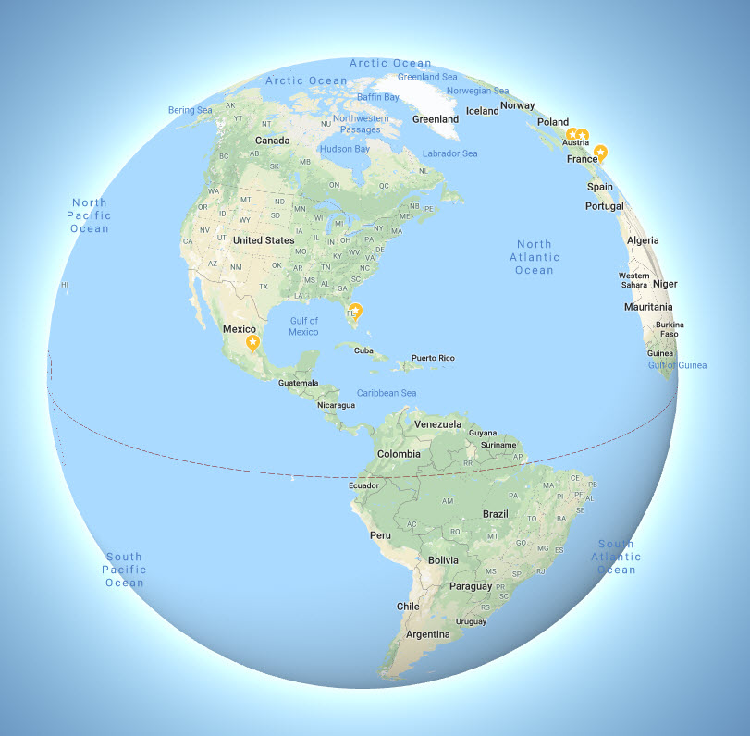
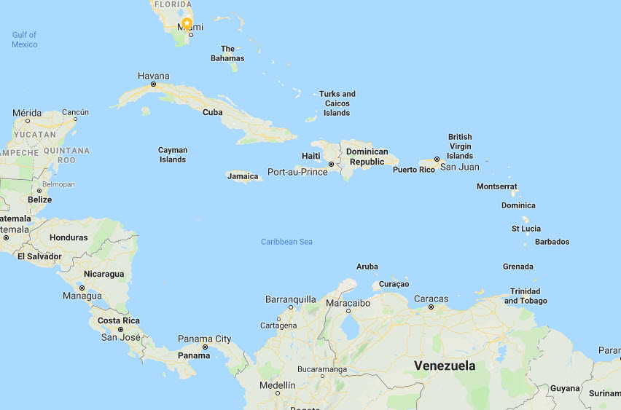
Overview on Cuba
Source: Google Maps

Slide 4
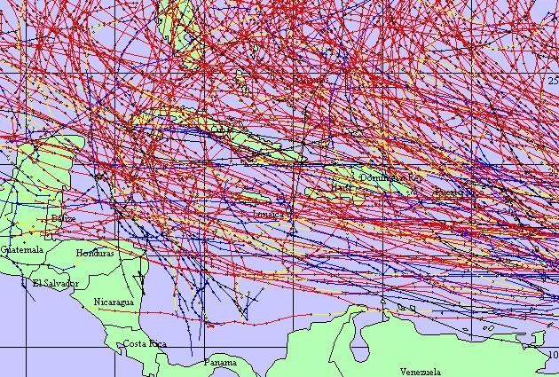
Overview on Cuba
Main Weather Hazard: HURRICANES
Source: Google Maps

Slide 5
Overview on Cuba
TORRENTIAL RAINS
Lowland Floodings
Flash Floodings in Cities
SEVERE THUNDERSTORM
Flash Floods
Strong Local Winds
Hail
Tornado
STRONG WINDS
COASTAL FLOODINGS
Source: Google Maps

Slide 6
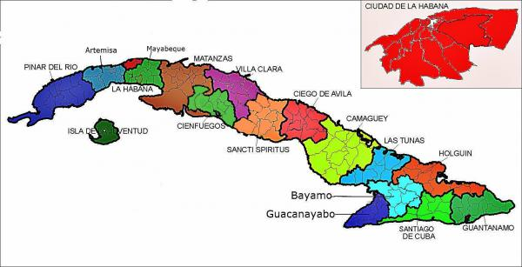
Overview on Cuba
Area:
110 922 km²
Coastline:
5 746 km
Population:
11 million
Capital:
Havana
2.5 million inh.
Havana
Havana Province
16 provinces

Slide 7
Cuban National Meteorological Service: Instituto de Meteorología
Havana
1 National
Meteorological
Center
16 Provincial
Meteorological
Centers
Havana Province
16 provinces

Slide 8
Cuban National Meteorological Service: Instituto de Meteorología
WEATHER STATION NETWORK IN CUBA
68 Meteorological Stations
1 Upper Air Sounding Station
2 Satellite Earth Station

Slide 9
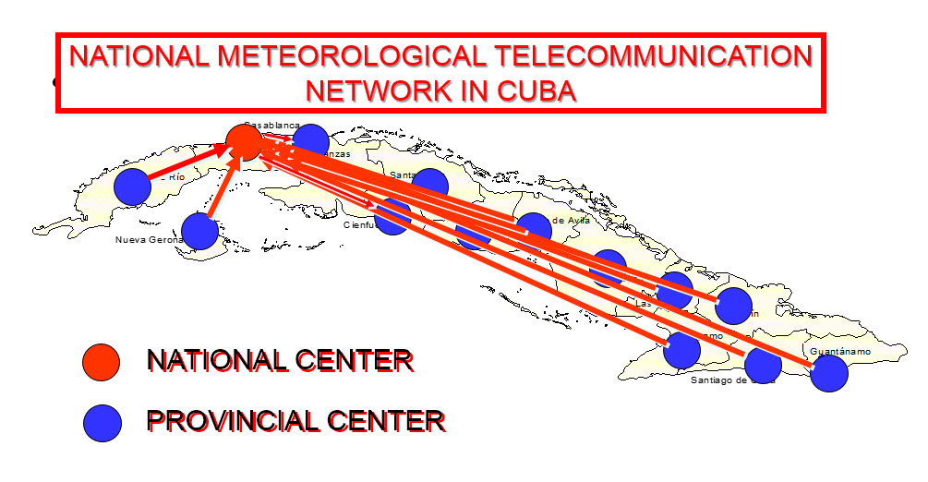
Cuban National Meteorological Service: Instituto de Meteorología
NMTN digitally provides all relevant exchange of meteorological information in the Country, linking the National Met. Center with all Provincial Met. Centers

Slide 10
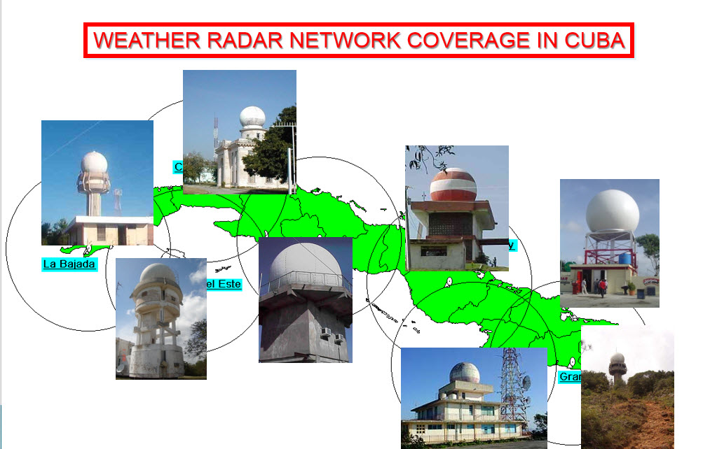
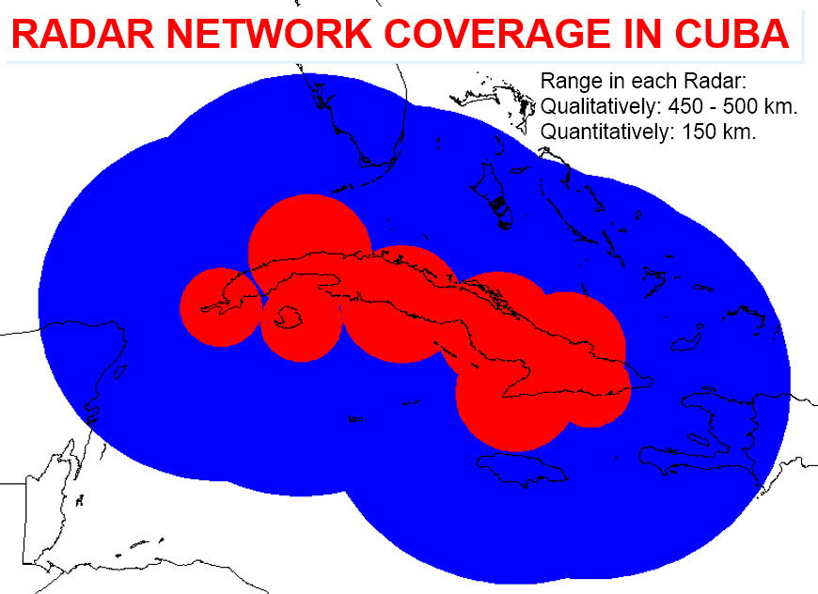
Cuban National Meteorological Service: Instituto de Meteorología
8 Weather Radars covers the entire Coutry and sea areas sorrounding Cuba

Slide 11
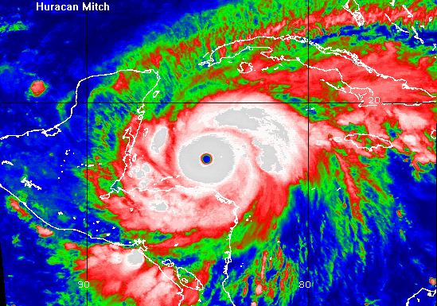
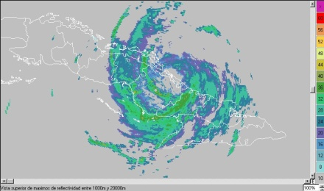
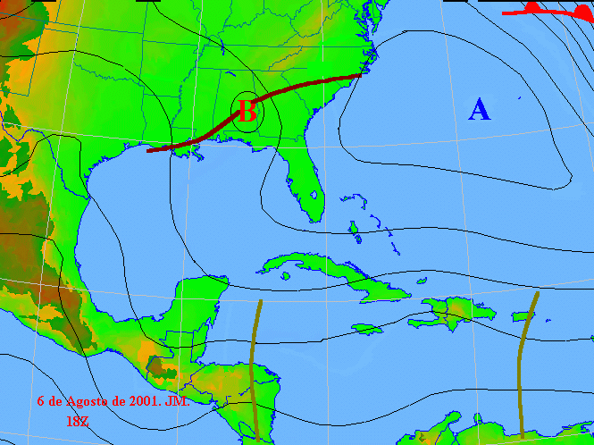
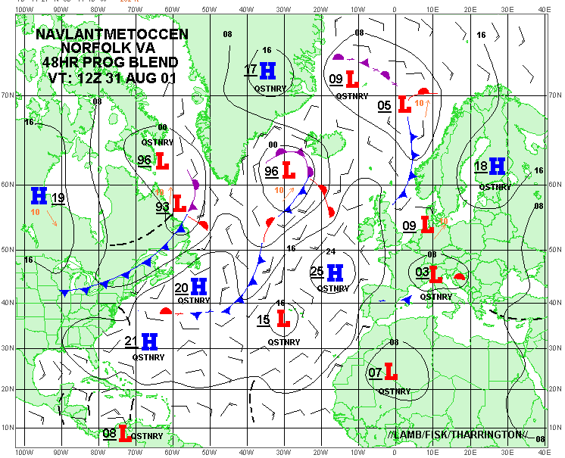
Cuban National Meteorological Service: Instituto de Meteorología
DATA INPUT
ANALYSIS AND
NUMERICAL GUIDANCE
DIFUSSION OF WARNINGS
RESPONSE ACTIONS
NATIONAL FORECAST
CENTER
SATELLITES
RADARS
WEATHER STATIONS UA SOUNDINGS SHIPS BUOYS AIRCRAFTS
NUMERICAL MODELS

Slide 12
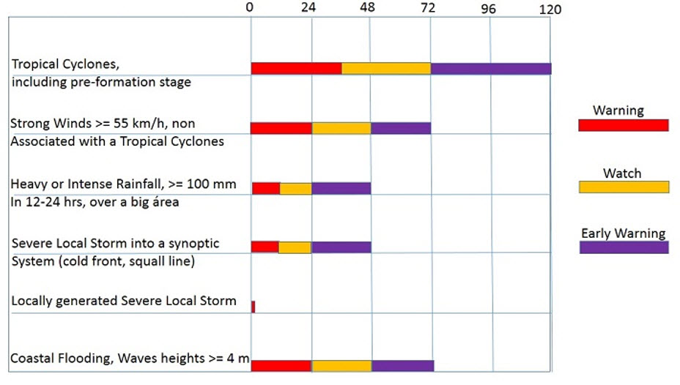
Why CAP Implementation
is a Need in Cuba?
Leading Time for Watches and Warnings in Cuba

Slide 13
Why CAP Implementation
is a Need in Cuba?
While Tropical Cyclones has a pretty good Watch and Warning System that has worked very well in years (just few or almost no fatalities in Cuba, even in very strong huracanes)
Leading Time for Watches and Warnings in Cuba

Slide 14
Why CAP Implementation
is a Need in Cuba?
Others, generally have not that success, because lead times are shorter and diffusion of information is not as effective as in hurricanes
Leading Time for Watches and Warnings in Cuba

Slide 15
Why CAP Implementation
is a Need in Cuba?
The main problem:
Local Severe Storm and its related features:
Flash Floods
Strong Winds
Wind Waves at the coast
Hail
Tornado
Leading Time for Watches and Warnings in Cuba

Slide 16
Why CAP Implementation
is a Need in Cuba?
The main problem:
Local Severe Storm and its related features:
Flash Floods
Strong Winds
Wind Waves at the coast
Hail
Tornado
Leading Time for Watches and Warnings in Cuba
Just 30 minutes or less of Lead Time for Warning a Small Area

Slide 17
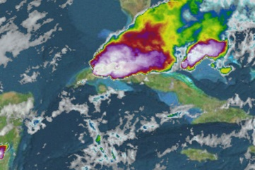
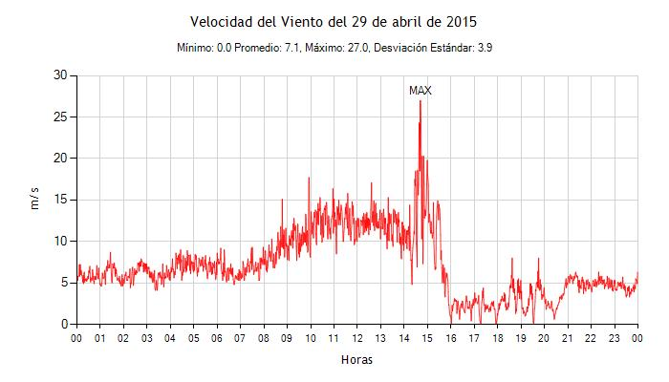
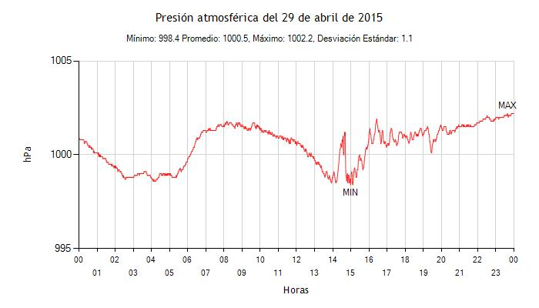
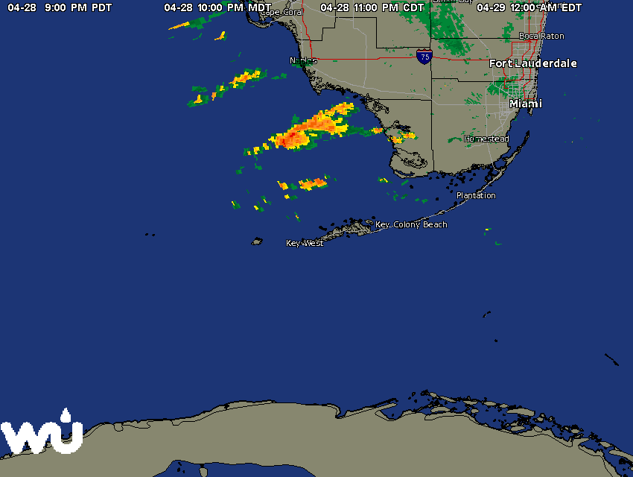
Why CAP Implementation
is a Need in Cuba?
CAP is the only way to alert people in very fast developing dangerous weather.
An example was the squall line that effected Havana (> 2 million inhabitants) on April 29, 2015.
Satellite
This severe local storm developed rapidly just in front of Havana.
Only a 20-min lead time to warn…. of course, the warning couldn´t go through….. Nobody received it before the event.
Radar
Winds were up to 27 m/s in a few minutes
Atmospheric Pressure dropped to 998 hPa

Slide 18
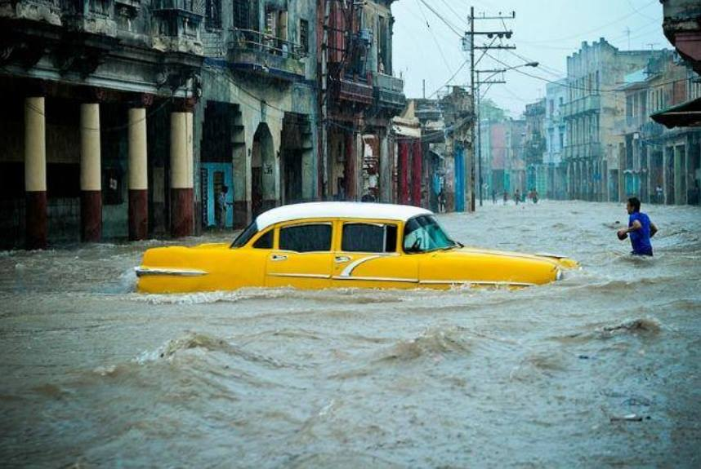
Why CAP Implementation
is a Need in Cuba?
The main hazard in this event was the heavy and intense rainfall that disrupted all normal affairs in the 2-million inhabitants city, but fortunately with just one fatality
Heaviest precipitation fell in about 20 minutes.
Greatest amounts were recorded in downtown Havana:
239 mm in Plaza de la Revolución;
197 mm in Cerro;
188 mm in Loma de la Cruz;
186 mm in La Palma; and
171 mm in Habana del Este

Slide 19
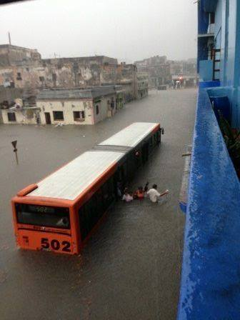
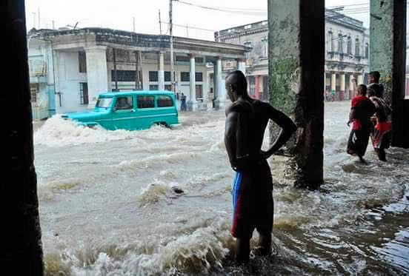
Why CAP Implementation
is a Need in Cuba?
City normal life completely disrupted in 15 minutes

Slide 20
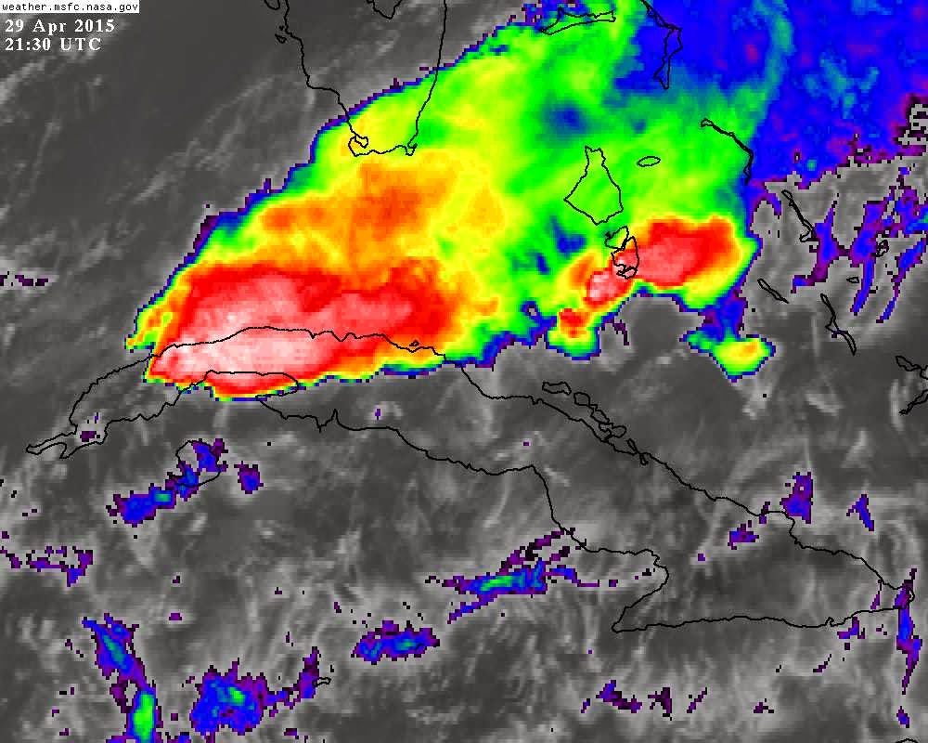
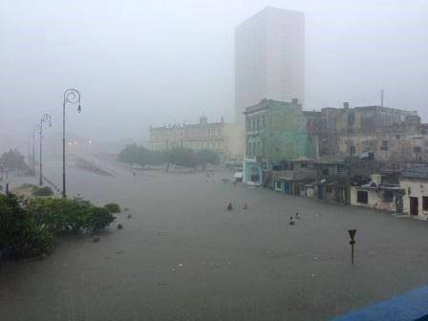
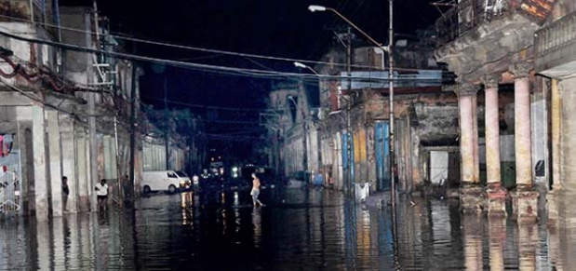
Why CAP Implementation
is a Need in Cuba?
The most intense rainfall lasted less than half an hour
The night fell over a flooded city that was without electric power
Havana completely under water

Slide 21
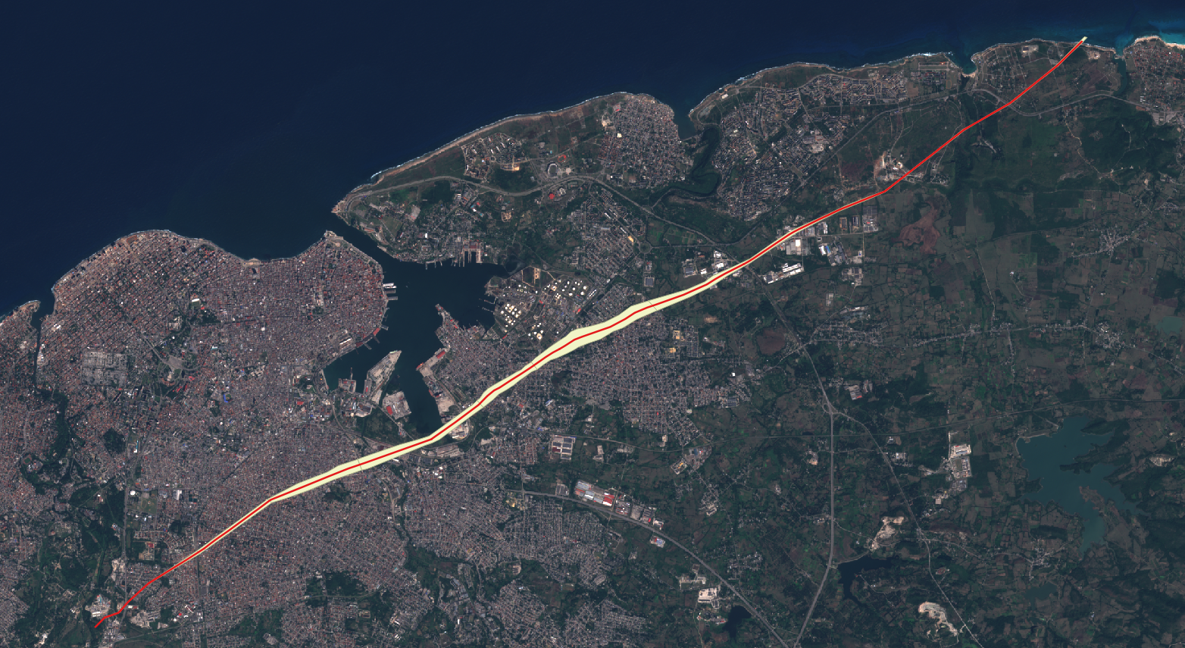
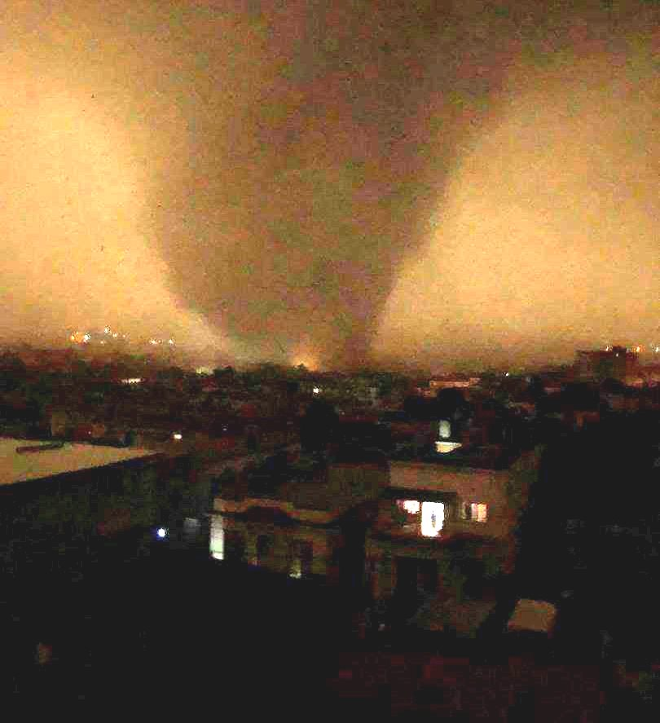
Why CAP Implementation
is a Need in Cuba?
Severe Local Storm with Very Strong EF-4 Tornado hits
Havana City January 27, 2019
AVERAGE TRANSLATION SPEED: 60.6 km/h
TRACK: 21.8 km
MAXIMUM WIDTH: 310 m
ESTIMATED WINDS: 320 km/h
DURATION: 20 minutos
HABANA
DEL ESTE
REGLA
GUANABACOA
SAN MIGUEL
DEL PADRÓN
CERRO
DIEZ DE
OCTUBRE

Slide 22
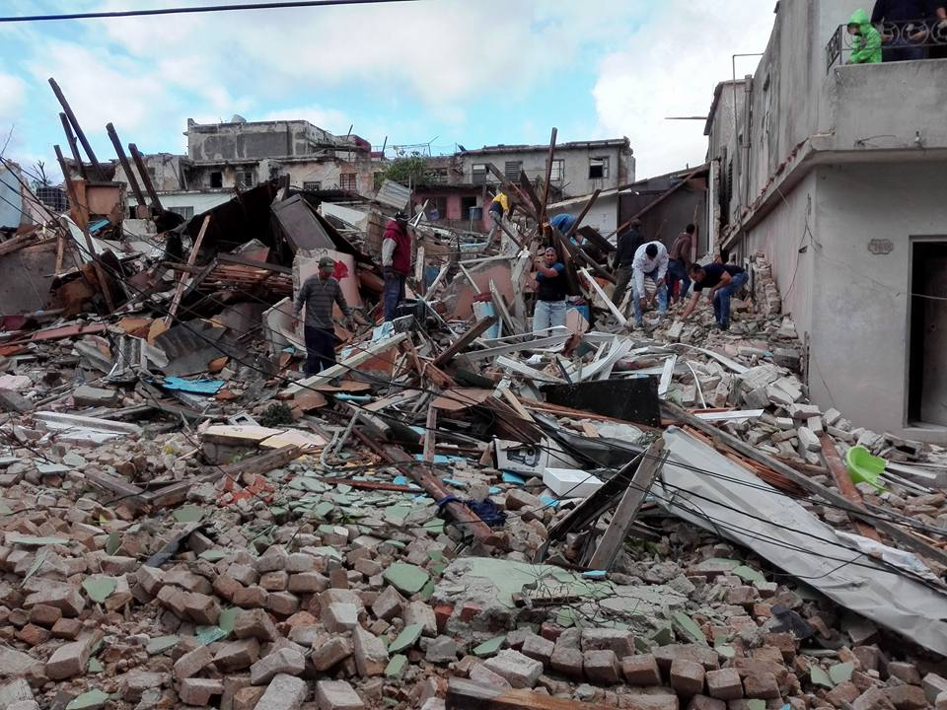
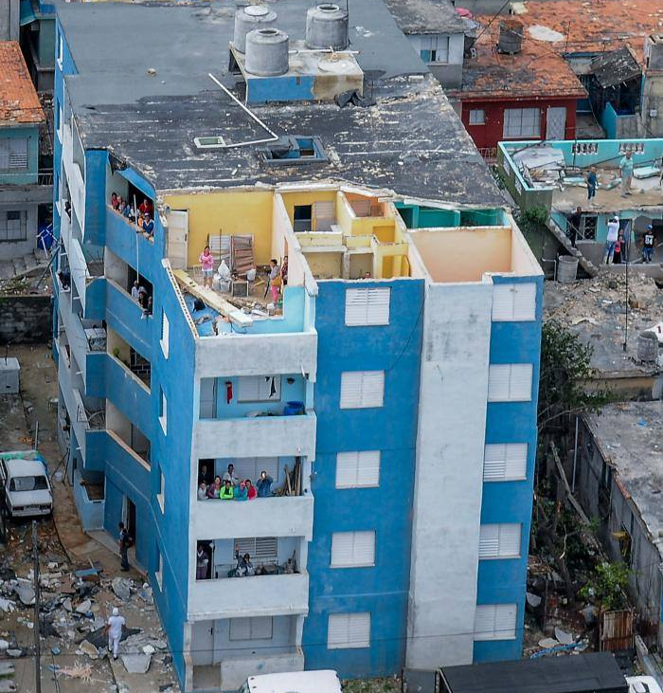
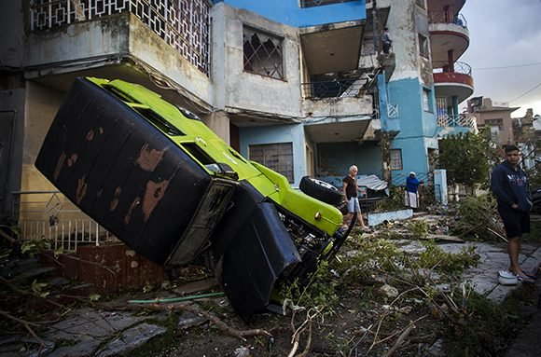
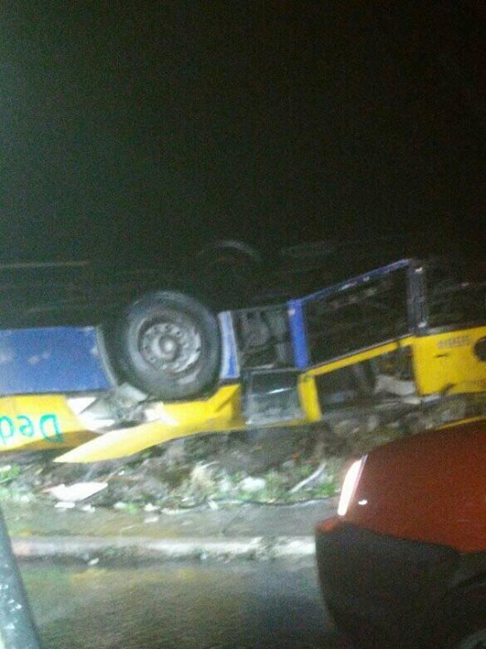
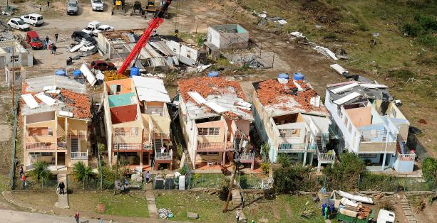
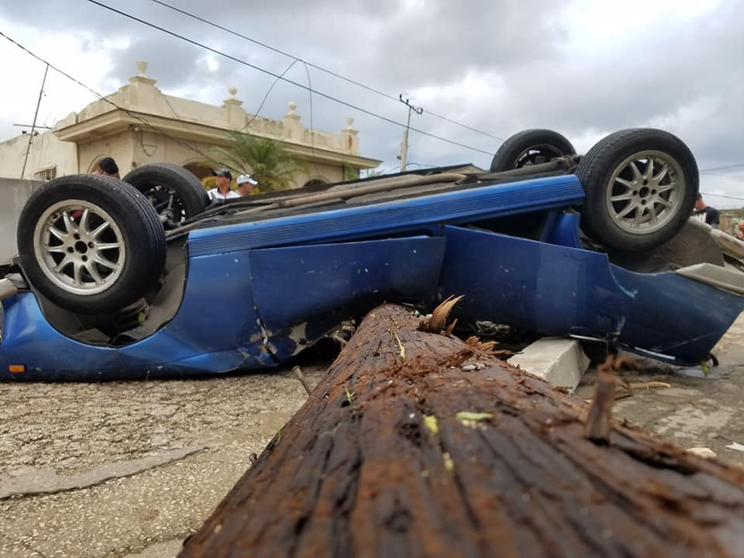
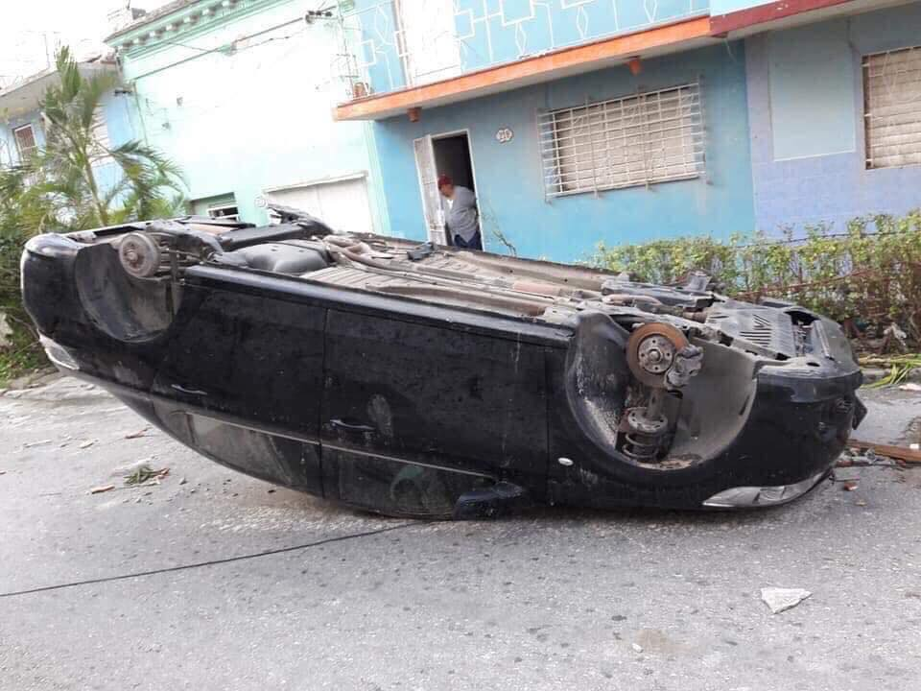
Why CAP Implementation
is a Need in Cuba?

Slide 23
Why CAP Implementation
is a Need in Cuba?
People´s Life Completedly Changed in those 20 minutes
Fortunatedly only 7 fatalities, but the Tornado swatch área was almost completedly destroyed
There was NO WARNINGS, other than general conditions favored severe thunderstorm áreas to develop in Western Cuba

Slide 24
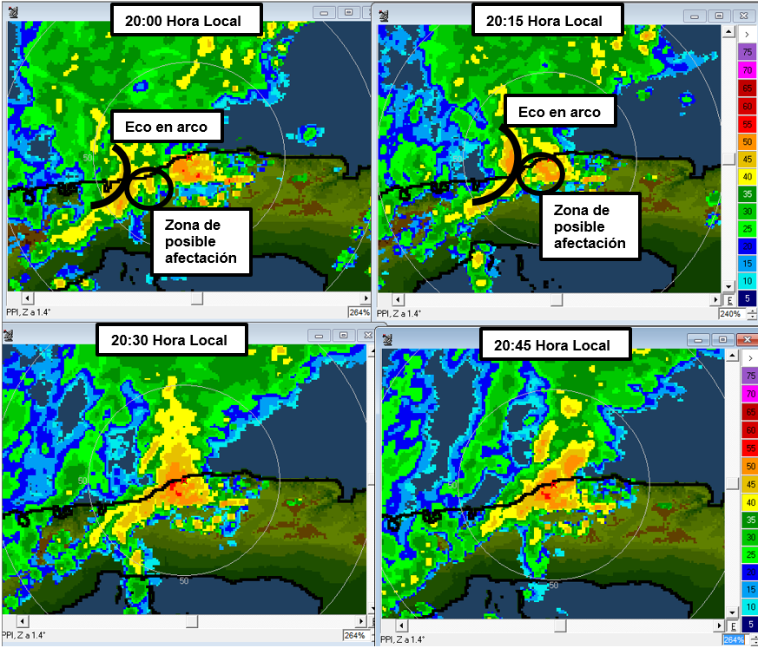
Why CAP Implementation
is a Need in Cuba?
With this information and CAP, something else could have been done to warn people on an impending threat
Havana Weather Radar Imagery
20:00 to 20:45
January 27, 2019.

Slide 25
Difficulties for the Use of CAP in Cuban Met Service at an earlier time
At InsMet:
Internal tests were made in 2015 using InsMet web page, with no graphic.
People that were trained al that momento, later moved to other positions outside InsMet.
Smart Alert Finnish software was installed in 2017, but technical problems prevented it to be fully operational.

Slide 26
Difficulties for the Use of CAP in Cuban Met Service at an earlier time
Country Infrastructure (2014 – 2018) also prevented the use of CAP:
Internet not widely used in the Country; Only available for a small amount of people, roughly 3 million users, 25 % of 11.3 million inhabitants in 2014.
Very Slow Internet connection, normally no wide band.
Very high cost for one-hour surfing of the web, around 8 - 9 % of an average monthly salary after a 50 % price off being in effect since July 2015.
Cell phone are available for many people, but still below 40 % of the population.
No Internet Connection in cell phones.

Slide 27
Evolution of Telecom and Internet
Cuba in late 2018 and 2019
Telecom scenario is rapidly changing in Cuba

Slide 28
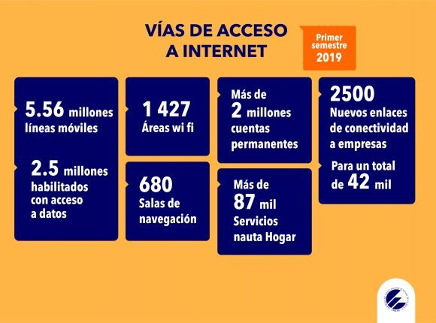
Evolution of Telecom and Internet
Cuba in late 2018 and 2019
Million Mobile Lines
Wi-Fi Areas
Permanent Accounts
New Contracts of Conectivity
to Enterprises
Million with Data Access
Surfing Places
Home Internet Connections

Slide 29
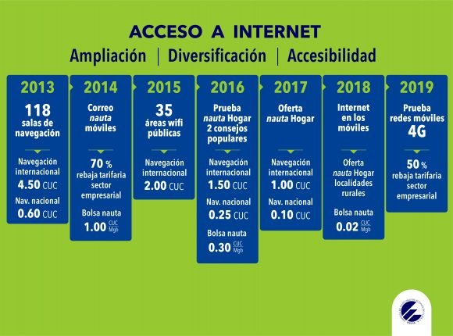
Evolution of Telecom and Internet
Cuba in late 2018 and 2019
Tests with 4G
Home
Internet Conections
Internet in Mobile Phones (3G)
Prices have been going down with time
Test of Home
Internet Conections

Slide 30
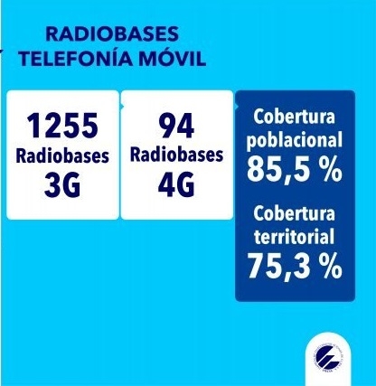
Evolution of Telecom and Internet
Cuba in late 2018 and 2019
Internet Coverage by Persons
At the End of 2019
3G Radio Base Stations
4G Radio Base Stations
Internet Coverage by Territory

Slide 31
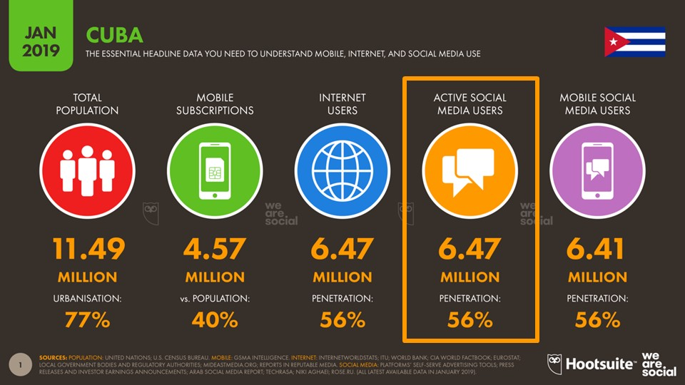
Evolution of Telecom and Internet
Cuba in late 2018 and 2019

Slide 32
Evolution of Telecom and Internet
Cuba in late 2018 and 2019
Conditions favor InsMet towards the Use of CAP in a New Fashion National Watch and Warning System

Slide 33
Inmediate Plan to Implement CAP
in Cuba 2020
The National Forecast Center of InsMet, as well as the 16 Forecast Departments in Provinces has the mandate to issue Weather Watches and Warnings for their respective territories of responsability, National or Provincial, in a completedly transparent and coordinated way, as it is stated in the National Operational Plan.
CAP comes as a very useful tool to acomplish that mandate.
The implementation of CAP in Cuba has been framed into a National Project, already approved by the Scientific Council of InsMet, with the Goal to improve the Weather Watches and Warnings System in the Country along 2020.
Some of the Tasks that have been identified into the Project Plan are the following:

Slide 34
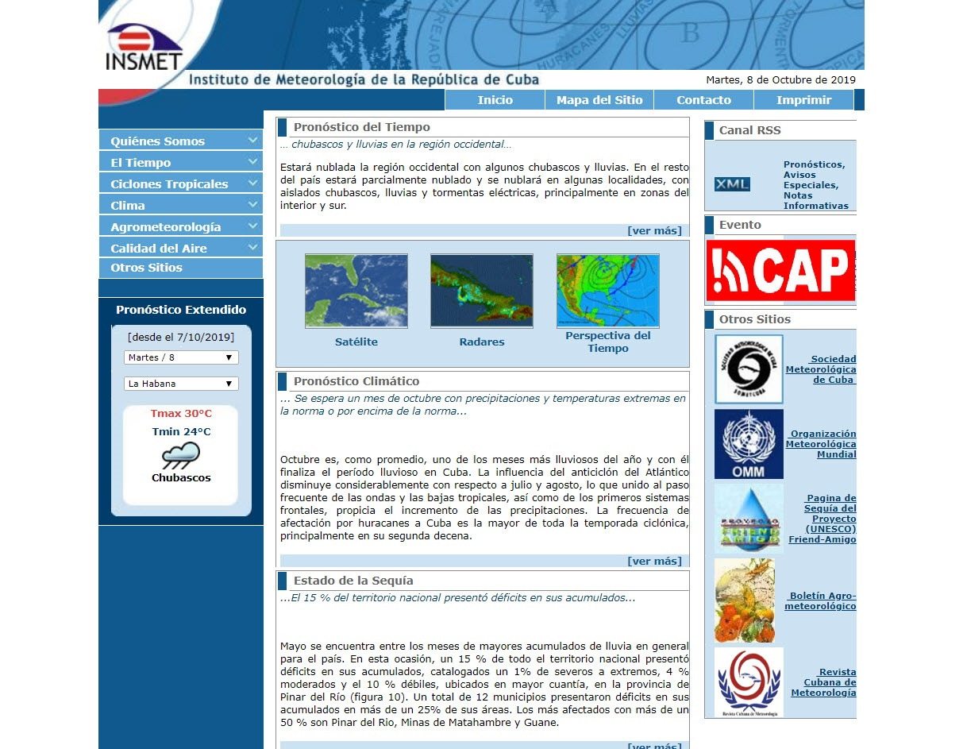
Inmediate Plan to Implement CAP
in Cuba 2020
To Train specialist at InsMet National Forecast Center on the National issuance of CAP Alerts
To Establish the Official issuance of CAP Alerts in the InsMet WEB and RSS feeds.
To Train specialist at the Provincial Meteorological Centers to issue CAP Alerts for their territory of responsability.

Slide 35
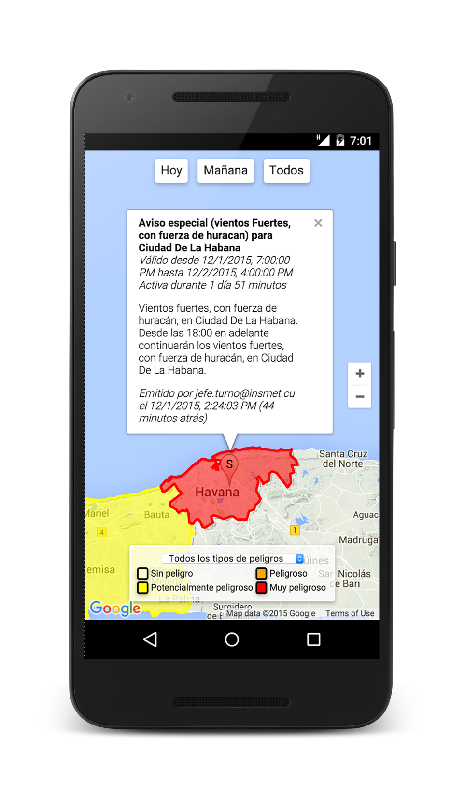
Inmediate Plan to Implement CAP
in Cuba 2020
To Begin displaying also Provincial CAP Alerts through the WEB and RSS feeds in the Provincial sites as well as in the InsMet website.
To Develop a National App to be installed into Intelligent Phones to automatically display Cuban CAP Warnings, both National and Provincial, as a Push Service through that free App, taking into account the basis of user location.

Slide 36
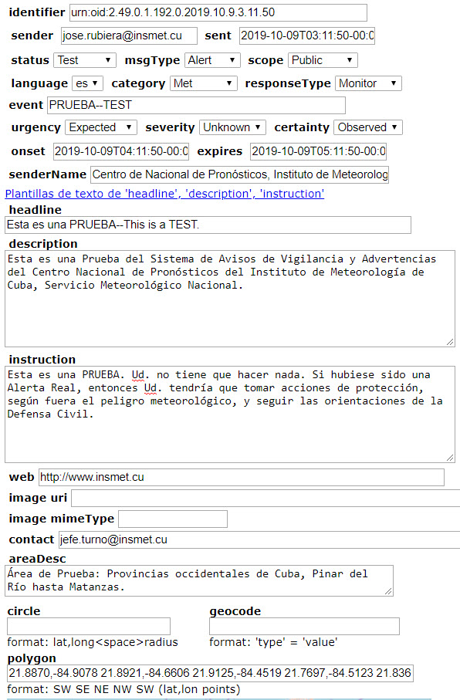
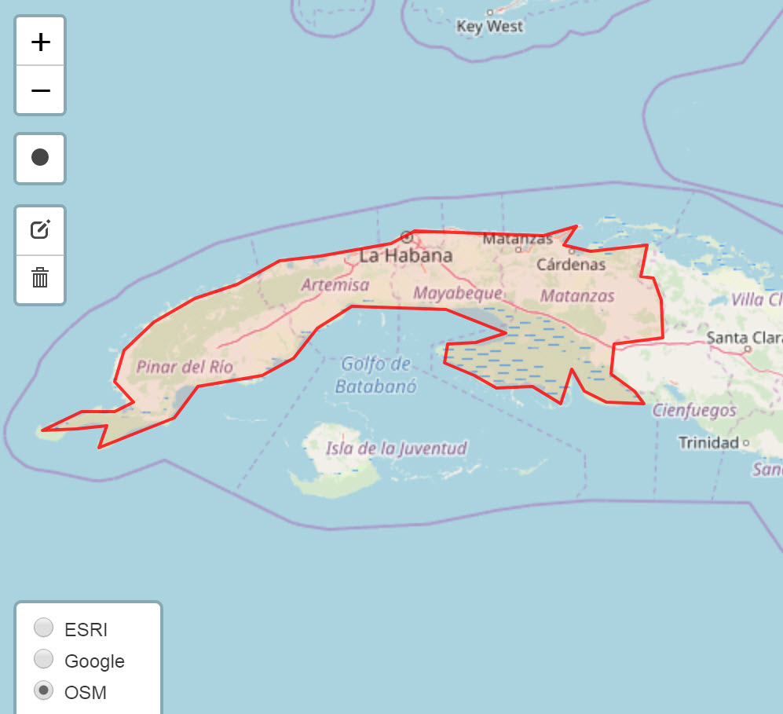
Inmediate Plan to Implement CAP
in Cuba 2020
A First Step, a Steady Purpose; we are Confident in its Success

Slide 37
Thank you,
Muchas Gracias
José Rubiera, Ph.D
Head of National Project:
¨Improving Weather Watches and Warnings
Processes in Cuba¨
rubiera.jose@gmail.com

