Slide 1
DATA RESPONSIBILITY - ROADMAP
25th May 2018: enforcement GDPR
Aug 2017

Slide 2
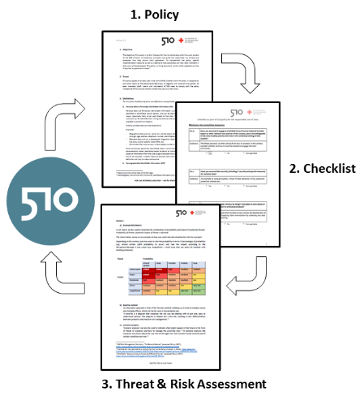
DATA RESPONSIBILITY – RELEASE OF POLICY
Release of:
Data Responsibility Policy (public)
Checklist (internal)
Threat & Risk analysis (internal)
Aug 2017

Slide 3
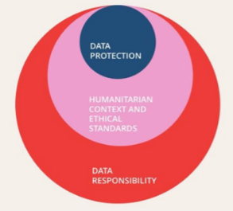
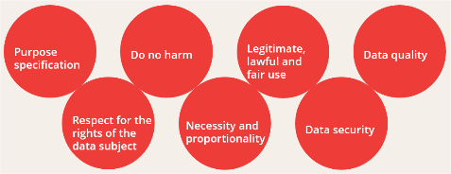
DATA RESPONSIBILITY – MORE THAN GDPR
Data Responsibility includes:
Data protection
Ethical standards
Humanitarian context
Based on 7 principles:
Aug 2017

Slide 4
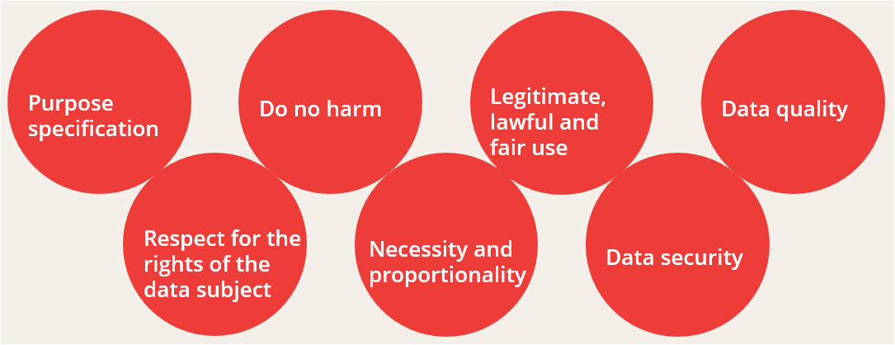
DATA RESPONSIBILITY – MORE THAN GDPR
Aug 2017

Slide 5
DATA RESPONSIBILITY – ACTIVITIES SEP – DEC ‘17
25th May 2018: enforcement GDPR
Activities:
Awareness Training of Team
External data literacy workshops
Collection of Feedback
Sep - Dec 2017

Slide 6
DATA RESPONSIBILITY – INITIAL FEEDBACK
Main feedback & insights:
“We’re lacking practical tools to deal with PII and DII data”
“Which role(s) do team members have for handling data?”
“Continue to learn from each other and from each other’s projects”
25th May 2018: enforcement GDPR
Jan 2018

Slide 7
DATA RESPONSIBILITY - LEARNINGS
Learnings from Cash Transfer projects:
Data is often not destroyed after serving its purpose.
It is often shared without checking purpose and consent given.
Cleaning of data is often not done.
25th May 2018: enforcement GDPR
Jan 2018 – March 2018

Slide 8
DATA RESPONSIBILITY - LEARNINGS
Learnings from Irma response St Maarten:
Do not use Google drive for storing personal data.
If Google drive is used then apply good password management.
May 2018
Jan 2018 – March 2018

Slide 9
DATA RESPONSIBILITY – SIMPLIFY & STANDARDIZE
25th May 2018: enforcement GDPR
Jan - April 2018
Centralized data repository implemented: MicroSoft Azure.
Internal comms solution implemented: MicroSoft Teams.
(Re)-use of templates.
Updated version of DR policy document in progress.

Slide 10
DATA RESPONSIBILITY – ACTIVITIES MAY
May 2018
25th May 2018: enforcement GDPR
Planned delivery: updated version of DR policy document.
Planned delivery of updated checklist.
Continuation internal and external communications.

Slide 11
Thank you!

