Slide 1
Community Resilience Assessment
Introductory Workshop

Slide 2
Training Approach
Goal: Learn resilience assessment methodology by practicing each step
What would you like to get out of this workshop?

Slide 3
Methodology Approach
Background Information: Resilience, Systems Thinking, Climate Change
Stage 1: Resilience of What: Identifying Systems
Stage 2: Resilience to What: Identifying Shocks & Stresses
Stage 3: Resilience for Whom: Understanding Dependencies
Stage 4: Identify Resilience
Stage 5: Future Scenarios
Stage 6: Setting Resilience Priorities

Slide 4
Day One Overview
Introduction and Expectations – 1 hour
Introduction to Climate Change, Risk, and Resilience – 1 hour
Mapping Systems – 1 hour
Identifying Interactions between Core Urban Systems – 1 ¼ hours
Learning to See Systems Activity – ¾ hour
Identifying Shocks & Stresses – 1 hour

Slide 5
Day Two Overview
Mapping Priority Shocks & Stresses – 1 hour
Understanding How Fragile Systems Impact People – 2 hours
Resilience Actions Across Scales – 1 hour
Historical, Current and Future Profiles – 1 hour
Road Map – 1 hour

Slide 6
Methodology Approach
Background Information: Resilience, Systems Thinking, Climate Change
Stage 1: Resilience of What: Identifying Systems
Stage 2: Resilience to What: Identifying Shocks & Stresses
Stage 3: Resilience for Whom: Understanding Dependencies
Stage 4: Identify Resilience
Stage 5: Future Scenarios
Stage 6: Setting Resilience Priorities

Slide 7
Introduction to Climate Change, Risk and Resilience
Objectives
Understand how building resilience can help us address climate change, urbanization and uncertainty
Understand Systems Thinking and the ‘Five Capitals + Governance’ Framework
Understand why resilience and systems thinking are needed to address uncertainty, particularly the uncertainty of climate change and urbanization

Slide 8
Disaster Risk Reduction, Climate Change Adaptation, and Resilience
Disaster risk reduction
Actions to minimize the vulnerability of people to disasters
Climate Change Adaptation
Actions to reduce vulnerability to changes in climate
Notes:
Resilience
Resilience
Is the ability to handle a variety of shocks and stresses, and to continue to function under a wide variety of conditions.
This is why we work on Resilience - Resilience is “the science of surprise”; it allows us to address uncertainty.
Many of the things we are already doing are building resilience:
Climate Change Adaptation
Actions to reduce vulnerability to changes in climate
Disaster risk reduction
Actions to minimize the vulnerability of people to disasters

Slide 9
Urban Systems
Ecosystems
Food, Water, Shelter
Energy
Education,
Public Security,
Health,
Planning,
Social Networks,
Adaptive Capacity
Financial Services,
Emergency Response
Transport, Communications
Core Systems
Notes:
Building resilience is particularly useful in situations where uncertainty makes it difficult to plan — for example, to address climate change, political instability, rapid growth, or economic instability.
But how do you plan if you don’t know what you need to plan for?
This is where systems thinking can help.
Systems-thinking works in situations where neither the problems nor the solutions are fully known.
This diagram shows some of the systems, either formal or informal, that people rely on.
The systems on the bottom of the triangle are the core systems; without ecosystems (rivers, farm fields, forests, etc.), food, water, and shelter, survival is nearly impossible.
In cities, energy, transportation and communication are also needed to support daily life and almost any type of livelihood.
The systems towards the top have developed as responses to development needs and changing conditions — they make complex modern livelihoods possible.

Slide 10
Five Capitals + Governance Framework for Resilience
Physical
Financial
Governance
Natural
Social
Human
Notes:
To maintain a resilient, thriving urban environment, we need to understand the core systems, the pieces that make up those systems, and how systems are interrelated and depend on other systems to work.
The Five Capitals + Governance Framework helps participants look at all the different parts of a system. Complicated, interconnected systems are easier to understand when you divide them up and look at the pieces one at a time.
The definitions of the capitals in this framework are:
Natural capital — the natural resource base that sustains livelihoods and wellbeing (e.g. water, forests);
Human capital — education, knowledge, skills and health of people;
Physical capital — the things produced by economic activity from other capitals such as infrastructure, equipment, livestock, etc.;
Financial capital — income sources and other financial resources that contribute to wealth;
Social capital — social relationships and networks, bonds that aid cooperative action, connections that support the exchange of and access to ideas and resources, social norms and values;
Governance — laws and policies, formal and informal rules and social norms, political and power structures.

Slide 11
Uncertainty
Notes:
In building resilience, once you have identified which systems you are focused on in your resilience building, the next step is to decide “to what” you are building resilience — e.g. floods, tsunamis, dengue
As soon as you start looking at “to what” you will quickly see that building resilience, even to a particular type of event, is challenging due to physical, social, economic and political processes and constraints. Change processes like migration, population growth, climate change, urbanization and development all mean that the future will be different from the present, and what exactly the future will be is very uncertain.

Slide 12
Climate Change and Uncertainty
How is climate change affecting your community?
How might climate change affect your community in the future?
Notes:
Climate change is one of the important change processes, and often an issue people don’t know much about or don’t feel they know how to address.
Climate change will not replace current weather with a new normal; instead, weather will keep changing, there will no longer be a “normal”. This means we cannot deal with climate change by just adapting to a set of expected changes. Instead, we must build resilience to new conditions that have high variability and uncertainty.

Slide 13
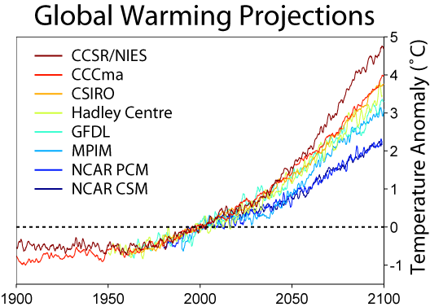
Climate Change
Notes:
When climate changes will happen and exactly what they will look like for any given location is uncertain.
However, in general, we know climate change is raising global temperatures.
As temperatures rise, what was previously “normal” weather changes.
Temperatures will increase. This will put stress on crops and on city infrastructure. It may increase power demand. Water temperature increases caused by air temperature increases, in streams, lakes and the ocean, will impact fisheries and will damage coral, weakening reefs.
Temperature variability will increase and temperature extremes will become larger. This will further stress people and crops, and could cause power demand spikes and result in power disruption.
Overall precipitation may increase or decrease, and timing of rainfall will become more variable. For example, the onset of the monsoon may become less predictable.
Precipitation intensity will increase. Heavy rains and flash flooding will occur more frequently.
Precipitation variability will increase. Dry seasons are likely to become drier and wet seasons wetter. The difference in rainfall from year to year may increase. “Monsoon failure”, droughts, and similar events may become more common.
Changes in precipitation and temperature may cause changes in disease outbreaks and in pest outbreaks.
Tropical storm paths may become more variable. Tropical storms may become more intense.
Sea levels, which are already rising, will continue to rise. The speed at which they rise will increase. Increases of as much as 1 meter by 2100 are possible.

Slide 14
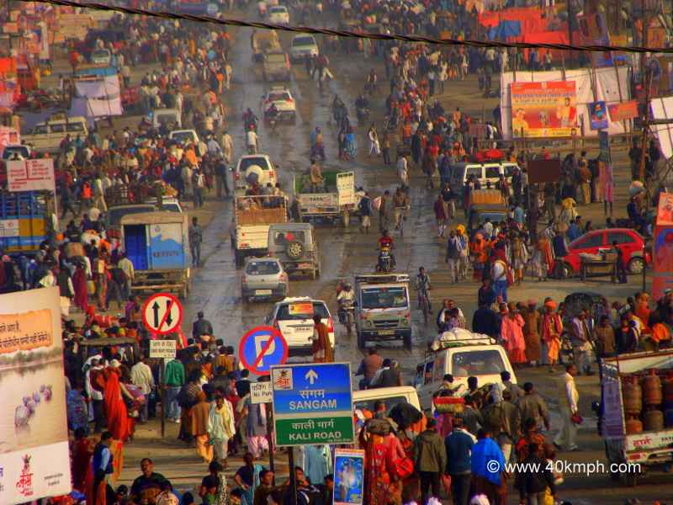
Urbanization
Notes:
Urbanization – is also contributing to uncertainty by creating enormous social, economic and environmental changes
If you want to build resilience, it is important to think about urbanization because it affects whether people can access systems, which systems they can access, and how well the systems they can access work. Over time, urbanization can also change or overwhelm the systems people rely on. For example, when new roads are built it can affect drainage and change when and where flooding occurs.
What change have you seen in your city or communities as a result of urbanization?
What are some positive changes that are reducing risk?
What are some negative changes that are increasing risk?

Slide 15
Methodology Approach
Background Information: Resilience, Systems Thinking, Climate Change
Stage 1: Resilience of What: Identifying Systems
Stage 2: Resilience to What: Identifying Shocks & Stresses
Stage 3: Resilience for Whom: Understanding Dependencies
Stage 4: Identify Resilience
Stage 5: Future Scenarios
Stage 6: Setting Resilience Priorities

Slide 16
Resilience of What: Mapping Systems Identifying Interactions between Urban Systems
Objectives
Identify and map core systems that are at risk of disruption
Identify past shocks and stresses that have resulted in the failure of city or community systems
Explore a key core system using the 5 Capitals + Governance Framework, and how trade-offs between the capitals can increase resilience.

Slide 17
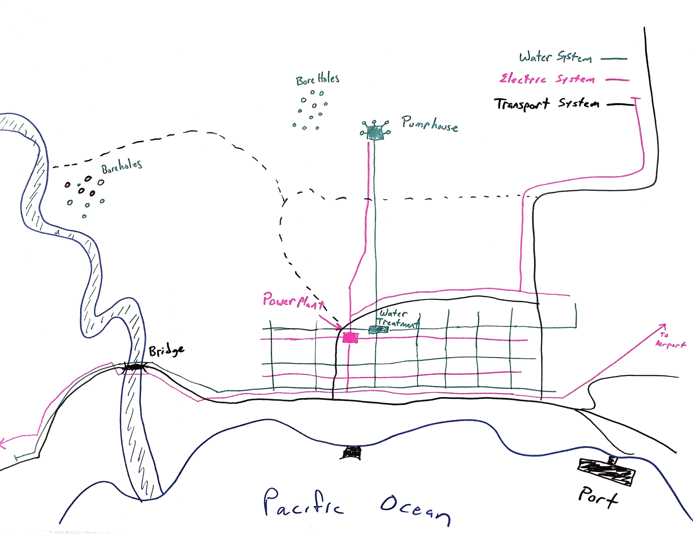
Notes:
Example systems map

Slide 18
Activity: Learning to See Systems
Objective:
Participants have a real-life feel for critical urban systems, and can identify them on their own.
Notes:
Learning to See Systems
Time needed: 45 mins
Objective:
Participants have a real-life feel for critical urban systems, and can identify them on their own
Option 1: As a group, visit an urban area and identify the critical urban systems that are visible and invisible (food, energy, water, communication, transportation, shelter).
Option 2: Using photographs, perform the same exercise. Below is a sample of how you might use a photo to teach how to pick out the systems in an urban environment.
Facilitators lead a discussion of critical urban systems that can be seen, can’t be seen, and/or are missing, how shocks/stresses might impact those systems, and what failure of those systems might do to other systems (cascading failures).

Slide 19
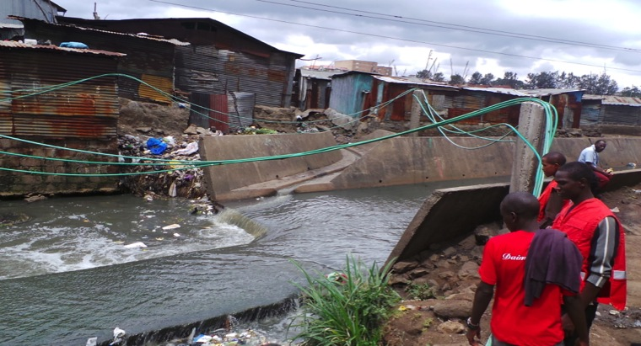
Recycling Business Opportunity
Widespread (but illegal) Electrical Connections
Functioning (but illegal) Water Connections
River not mitigated for flood
Notes:
Use this picture, use pictures of the city/communities you are working in, or go outside and look around.

Slide 20
Discussion Questions
What systems do you see? Which systems do you NOT see?
What systems in this area tend to break? What causes them to break? Who is most affected?
How are other systems affected by that disruption?
What are possible Disaster Risk Reduction, Climate Change Adaptation and/or resilience interventions to improve the situation at the local, city, or other scale?
Who/what departments or organizations would you need to engage to make those interventions happen?

Slide 21
Methodology Approach
Background Information: Resilience, Systems Thinking, Climate Change
Stage 1: Resilience of What: Identifying Systems
Stage 2: Resilience to What: Identifying Shocks & Stresses
Stage 3: Resilience for Whom: Understanding Dependencies
Stage 4: Identify Resilience
Stage 5: Future Scenarios
Stage 6: Setting Resilience Priorities

Slide 22
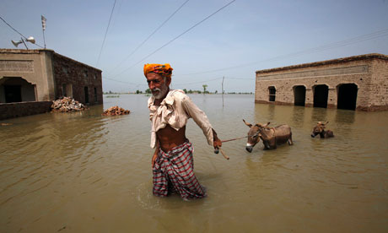
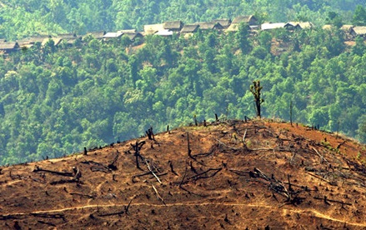
Shocks and Stresses
Shock: Rapid events
Stress: Long-term pressures or conditions

Slide 23
Shocks and Stresses
What are some typical shocks?
What are some typical stresses?

Slide 24
Resilience to What: Identifying Shocks & Stresses
Objectives:
Identify the primary shocks and stresses in the city.
Sort shocks and stresses according to their frequency and impact.
As a group, agree on the top shocks and stresses of concern.

Slide 25
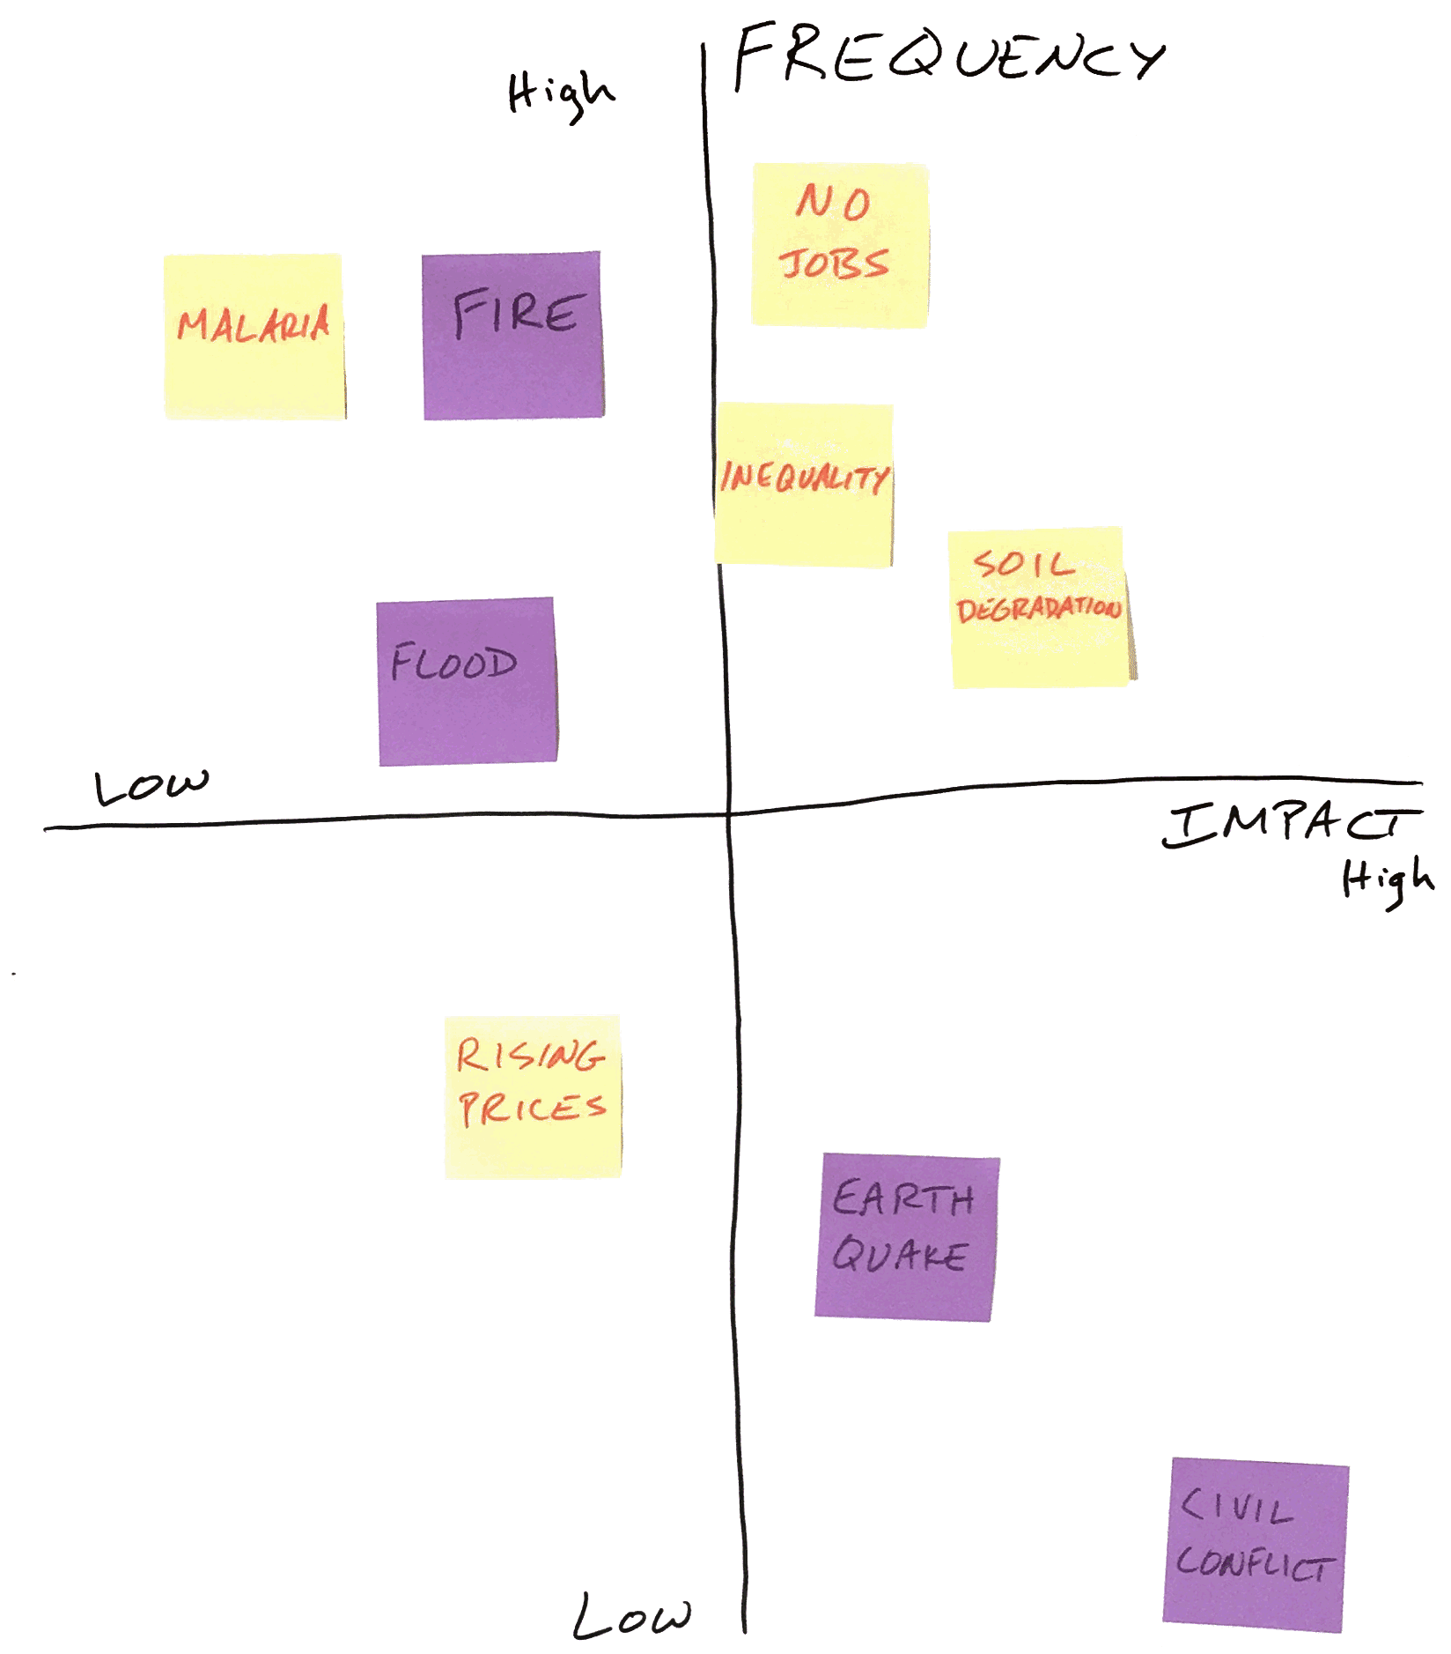
Notes:
Example shocks and stresses chart

Slide 26
Discussion Questions
Did all the groups come up with the same priority shocks and stresses?
Are there low frequency/high impact events that might be an issue?
Would your current coalition partners choose the same shocks and stresses?

Slide 27
Day Two Overview
Mapping Priority Shocks & Stresses – 1 hour
Understanding How Fragile Systems Impact People – 2 hours
Resilience Actions Across Scales – 1 hour
Historical, Current and Future Profiles – 1 hour
Road Map – 1 hour

Slide 28
Methodology Approach
Background Information: Resilience, Systems Thinking, Climate Change
Stage 1: Resilience of What: Identifying Systems
Stage 2: Resilience to What: Identifying Shocks & Stresses
Stage 3: Resilience for Whom: Understanding Dependencies
Stage 4: Identify Resilience
Stage 5: Future Scenarios
Stage 6: Setting Resilience Priorities

Slide 29
Resilience to What: Mapping Priority Shocks and Stresses
Objective:
Add to your map of core urban systems the areas in the city that are affected by your priority shocks and stresses.

Slide 30
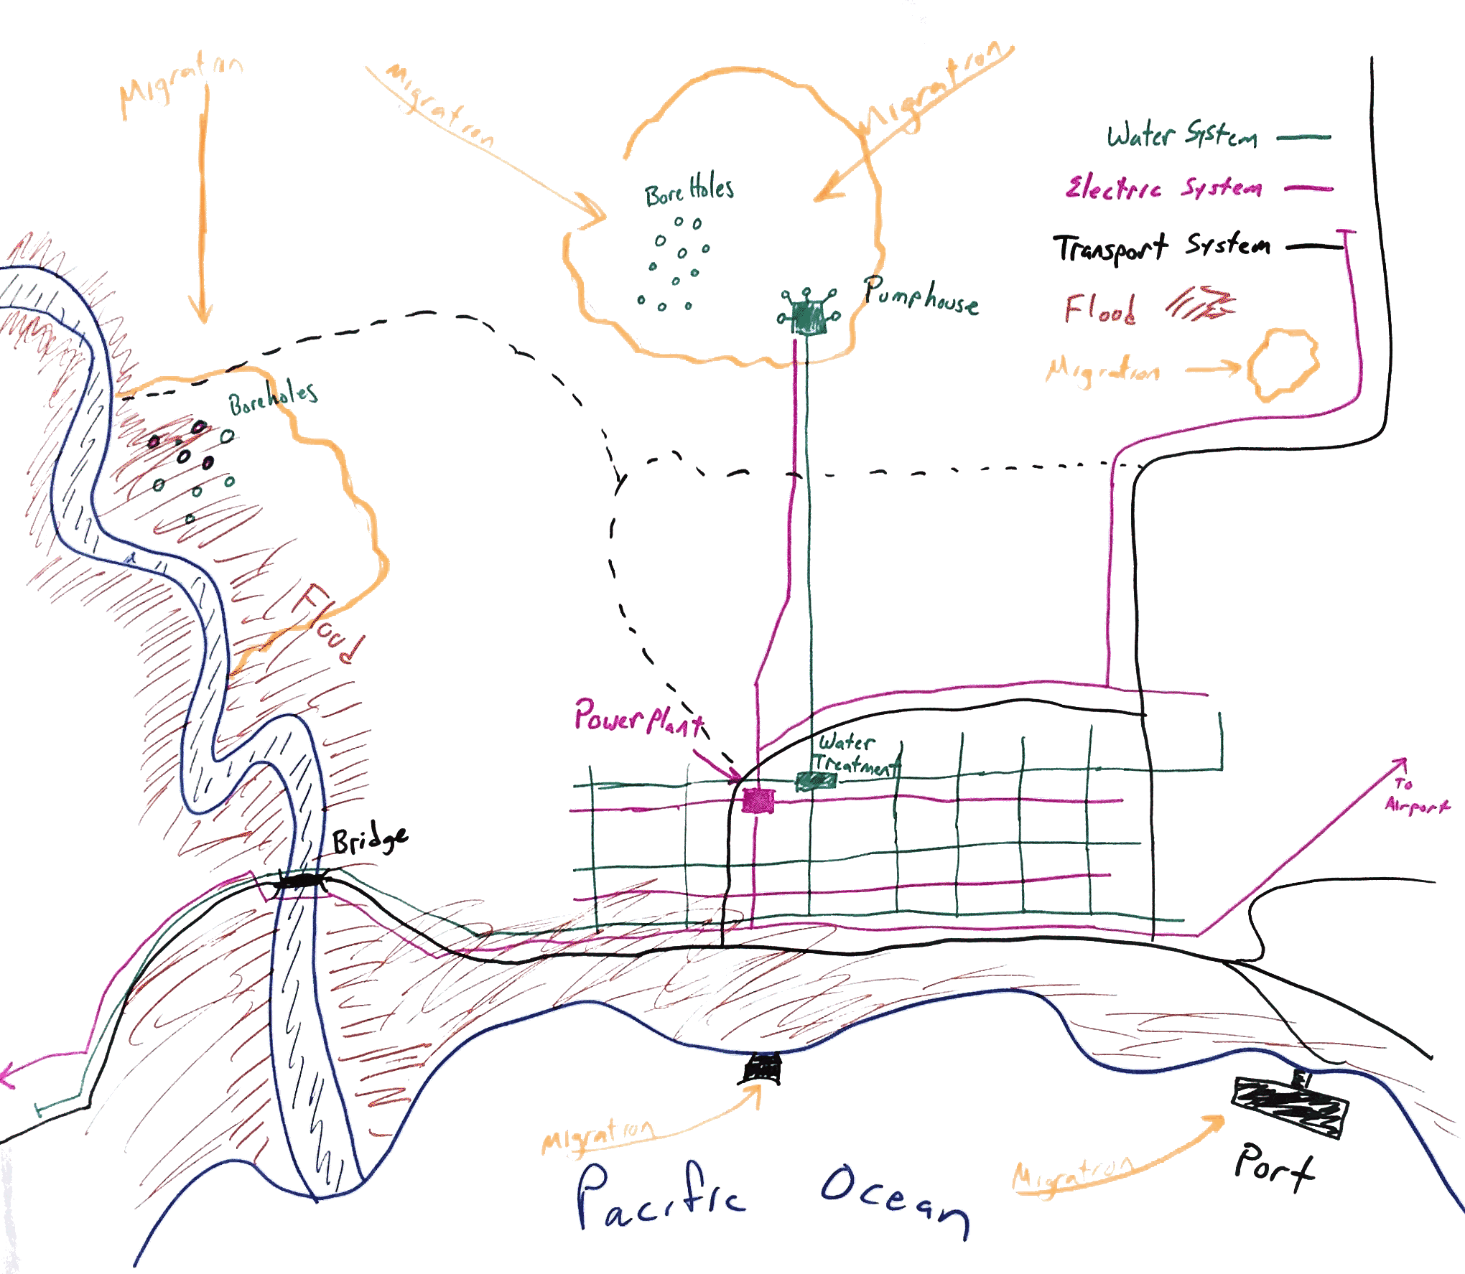
Notes:
Example of shocks and stresses added to systems map

Slide 31
Discussion Questions
What are the similarities and differences between each group’s maps?
Which systems are most disrupted by the prioritized shocks and stresses?
What didn’t you know about? How could you find out?

Slide 32
Methodology Approach
Background Information: Resilience, Systems Thinking, Climate Change
Stage 1: Resilience of What: Identifying Systems
Stage 2: Resilience to What: Identifying Shocks & Stresses
Stage 3: Resilience for Whom: Understanding Dependencies
Stage 4: Identify Resilience
Stage 5: Future Scenarios
Stage 6: Setting Resilience Priorities

Slide 33
‘For Whom’ Are You Building Resilience
The people affected by a system’s failure are not necessarily located in the same location as the system itself. The impact of system failure depends on both the exposure and the sensitivity of different groups of people and stakeholders to system failure.
Exposure: The degree to which something or someone experiences a hazard.
Sensitivity: The degree of impact a hazard has on something or someone.
Notes:
Exposure is primarily a function of geography. For example, the failure of a transformer will cause power outages in the area it serves and therefore affect the people in that area. However, people located in other parts of the city may also be exposed if they are dependent on the power in that part of the city for transportation, communication, livelihoods activities, etc.
Sensitivity is the degree to which a given community or population is affected by system failure. For example, for a power disruption, people with backup power or those who are less dependent on power will be less sensitive.

Slide 34
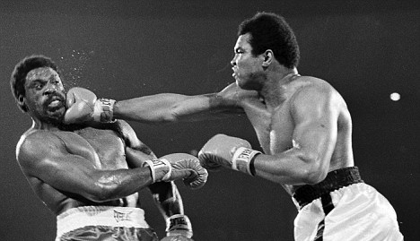
Exposure: Number of times punched

Slide 35
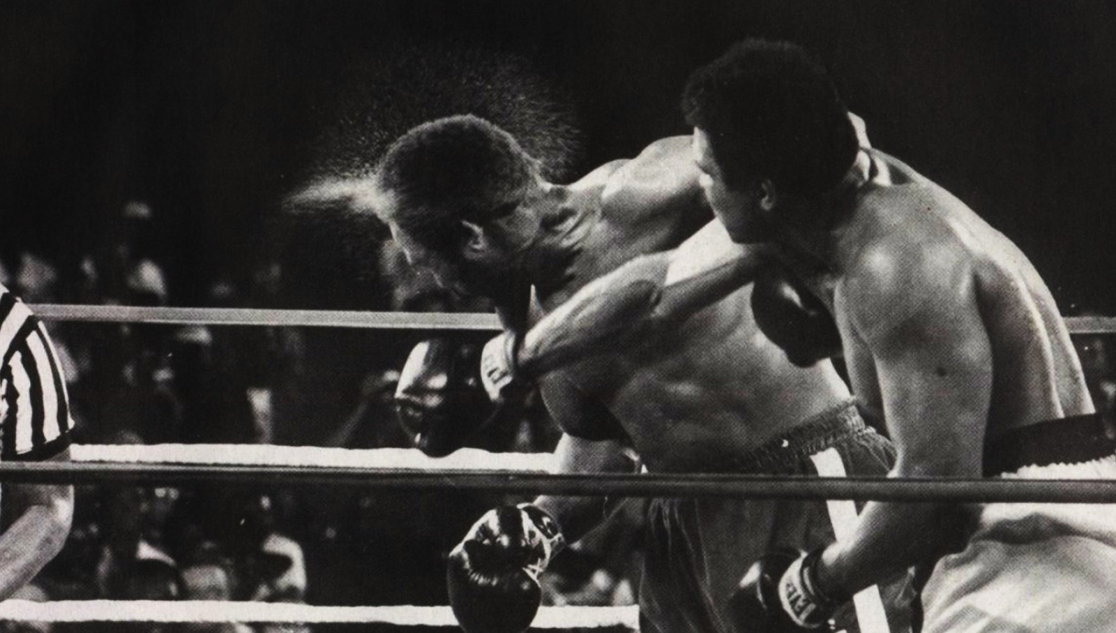
Sensitivity: How much it hurts

Slide 36
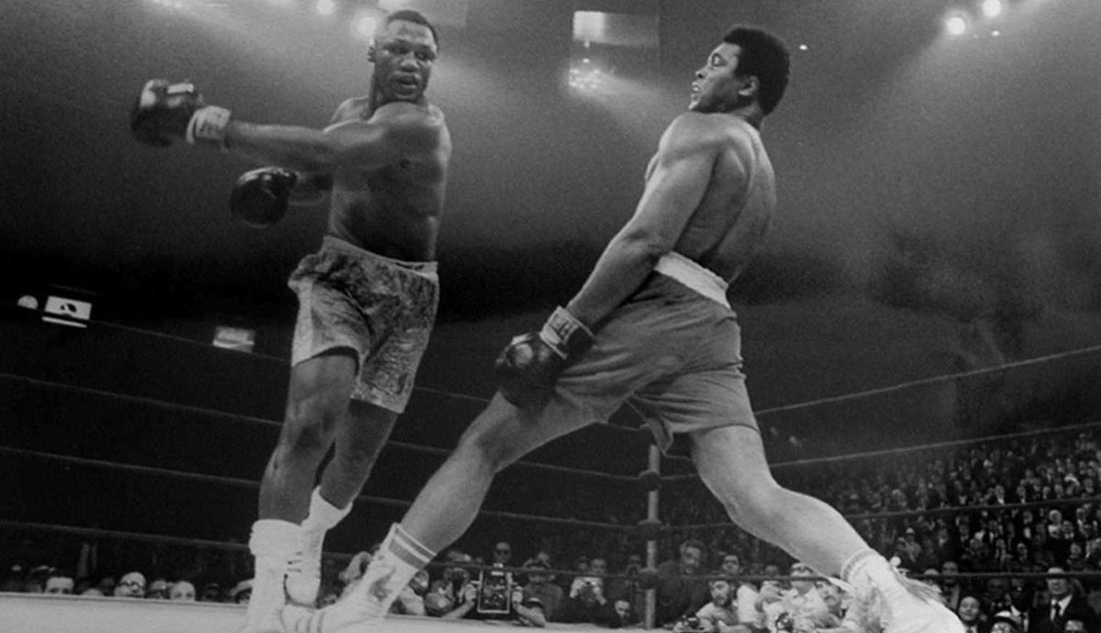
Risk Reduction and Adaptation: How quickly you can move away
Notes:
Even if you are exposed and sensitive to a shock or stress, you may have ability to deal with it well so it doesn’t affect you much.
If you are exposed to flooding, a good draining system built to accommodate lots of water can reduce your sensitivity.
Fire may be a problem, but if the fire response system is good, it can reduce expose and if there is a good system of educating people about how to prepare for and respond to fire, they can reduce their sensitivity.

Slide 37
Resilience for Whom: Understanding How Fragile Systems Affect People
Objectives:
Explore how impacts to core systems affect the people who depend on those systems.
Understand not just who is exposed but who is most sensitive to which shocks and stresses.
Discuss how those who are affected by failure of a given system are connected to other people and systems within the city.

Slide 38
Discussion Questions
Which systems are most disrupted by the identified shocks and stresses?
Which stakeholders are most affected by or most sensitive to disruptions to these systems?
Why are these stakeholders affected by the fragility of these systems? Is there another capital that could be increased to help compensate for their sensitivity to this system failure?
Who are the stakeholders maintaining or responsible for these systems? Who has power to affect whether these systems work or not

Slide 39
Methodology Approach
Background Information: Resilience, Systems Thinking, Climate Change
Stage 1: Resilience of What: Identifying Systems
Stage 2: Resilience to What: Identifying Shocks & Stresses
Stage 3: Resilience for Whom: Understanding Dependencies
Stage 4: Identify Resilience
Stage 5: Future Scenarios
Stage 6: Setting Resilience Priorities

Slide 40
Identify Resilience: Resilience Action Across Scales
Objective:
Identify current resilience building interventions occurring within communities, at the city scale, and at higher scales related to the priority shocks and stresses.

Slide 41
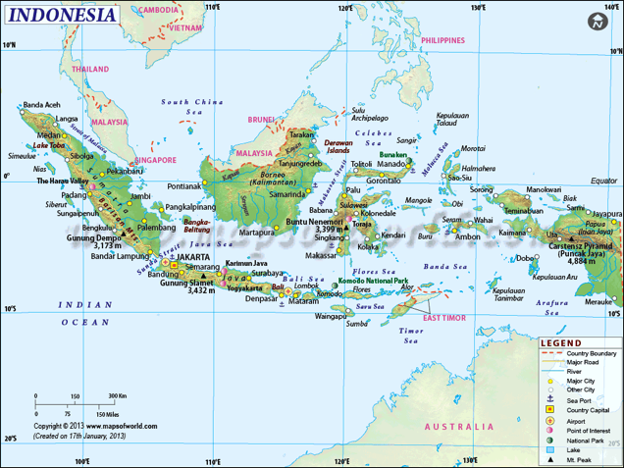
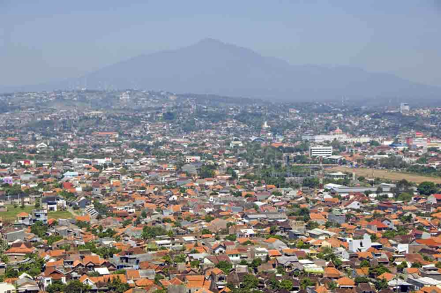
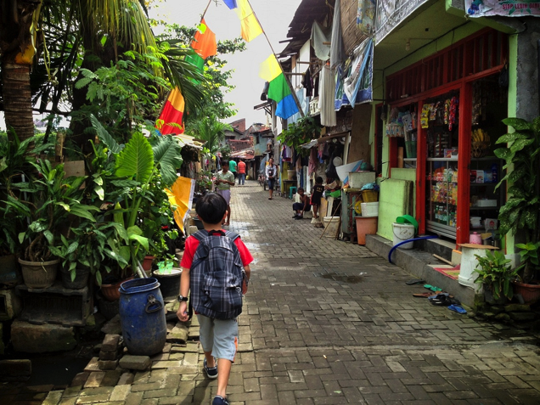
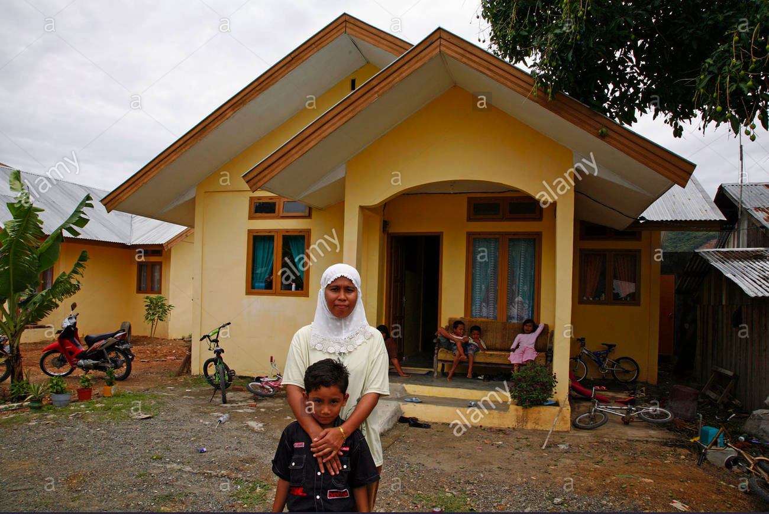
Scales
National
Provincial
City-wide
Community
Local

Slide 42
Level of Action
Provincial/National
Climate study
National grain bank
Building sea wall
City evacuation plan
City-wide
Building houses on stilts
Local mosques and churches as emergency shelters
Farmers adopt drought resistant seeds
Local
Sea Level Rise
Volcanic Eruption
Drought
Shocks and Stresses

Slide 43
Discussion Questions
Do current actions address your prioritized shocks and stresses? At the national level? At the city level? In communities?
Where are local actions taking place? Are there parts of the city or key communities that are left out?
Are the vulnerable communities and fragile systems identified earlier being addressed?
Where can neighborhood-level efforts better support city-level resilience?
Where can city-scale efforts better support at risk communities?

Slide 44
Methodology Approach
Background Information: Resilience, Systems Thinking, Climate Change
Stage 1: Resilience of What: Identifying Systems
Stage 2: Resilience to What: Identifying Shocks & Stresses
Stage 3: Resilience for Whom: Understanding Dependencies
Stage 4: Identify Resilience
Stage 5: Future Scenarios
Stage 6: Setting Resilience Priorities

Slide 45
Future Scenarios: Historical, Current and Future Profiles
Objectives:
Understand how much the city has changed in the past 20 years
Understand how urbanization and climate change could influence the future 20 years from now.

Slide 46
Discussion Questions
What are the biggest changes that have occurred over the past 20 years in each of the five capitals categories?
What changes could occur over the next 20 years based on past trends?
Will there be new shocks or stresses in the future that are currently not experienced or not a problem?
Which people and what locations and systems will be exposed? Which people and what locations and systems will be sensitive and why will they be sensitive?
What actions could be started today to reduce that exposure or sensitivity?

Slide 47
Methodology Approach
Background Information: Resilience, Systems Thinking, Climate Change
Stage 1: Resilience of What: Identifying Systems
Stage 2: Resilience to What: Identifying Shocks & Stresses
Stage 3: Resilience for Whom: Understanding Dependencies
Stage 4: Identify Resilience
Stage 5: Future Scenarios
Stage 6: Setting Resilience Priorities

Slide 48
Setting Resilience Priorities: Road Map for Building Resilience
Objective:
Identify resilience gaps and opportunities based on prior activities and analysis, with emphasis on action and collaboration across scales.

Slide 49
Review the Results
Priority shocks and stresses | Core Systems Affected | Key Stakeholders affected | Gaps in current resilience actions | Initial Ideas for Resilience Actions | Key Partners

Slide 50
Discussion Questions
Did participants identify similar resilience actions? In not, why not?
Have you identified groups or individuals as key partners who have not been part of the assessment process to date? How can you get them involved?
Are your resilience actions in the form of projects, or more general concerns that you must address? What is the next step to turn them into real projects?
Notes:
Throughout the workshop or assessment process, participants will generate conclusions in each exercise and activity. However, these conclusions are often not integrated with conclusions from prior activities, because of lack of time or simply because how the activities are connected isn’t clear. As a result, integrating the conclusions from individual activities together to figure out what to do in the future can be hard. Encourage people to take sufficient time to review the conclusions from the individual tools and think about how they fit together into a big picture before they start proposing solutions.
If these tools are being introduced in an introductory workshop, have participants focus on what steps they need to take to begin their resilience assessment and who will play what roles rather than on filling out the final Worksheet. They will not have gone into enough depth with the tools, nor had the opportunity to look for missing information and players, to have a clear picture about what actions need to be taken to build resilience. They will, however, have a much clearer picture of what their assessment process needs to look like and who should be involved. Before concluding this final activity, have people make commitments for what they will do over the next 2-4 months to actually conduct a resilience assessment.

Slide 51
Thank you!

