Slide 1

CAP via MQTT
Efraim Petel
President, AlertNet-USA, Inc.
efraimp@alertnetusa.com
AIM:
Explain using
MQTT in CAP Warning Systems
For faster alerts
GOAL:
Provide the workshop participants
with information
to support their quest
for better warning systems
Notes:
Good afternoon, ladies and gentlemen.
The aim of my presentation is to explain how to use MQTT in CAP warning system for faster alerts.
And the goal is to provide you with information that will support you when you develop your systems.

Slide 2
In this presentation:
Solution overview: CAP over MQTT
01
Problem statement: speed
02
Solution Overview : MQTT
03
04
05
Solution Benefits
Next Steps
Notes:
To do that I will first explain what is the problem that we are facing,
I will provide an overview of the MQTT solution,
explain how CAP work over MQTT,
and show you the solution benefits and the next steps.

Slide 3
01: Problem statement: speed
Solution overview: CAP over MQTT
01
Problem statement: speed
02
Solution Overview : MQTT
03
04
05
Solution Benefits
Next Steps
Notes:
I will start with the problem that caused us to look into the MQTT protocol which is SPEED..

Slide 4
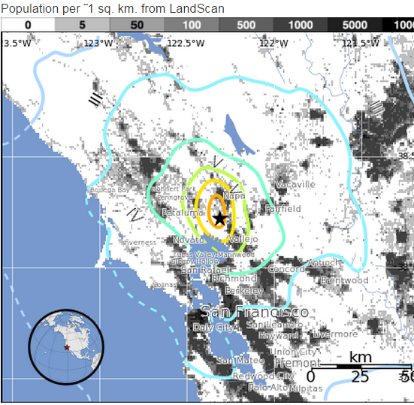
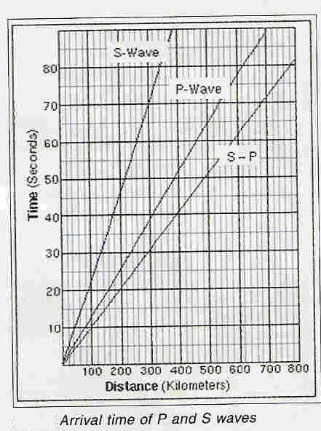
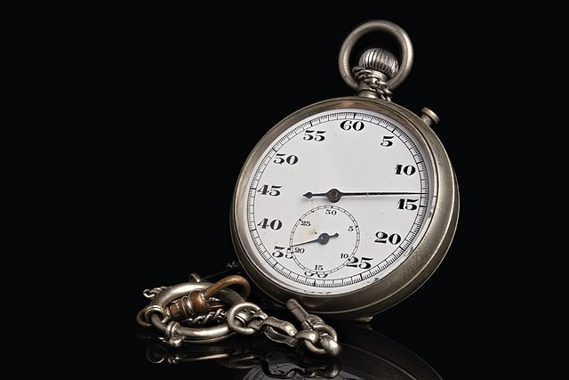
Problem Statement – Speed!
Seismic wave arrival to SF peninsula is 10-16 seconds
Notes:
Assuming we already know how to alert our people, the question now is: will we alert in time? In the past, warning system meant to alert against weather hazards that were at least a few minutes away. Now, with the better hazard detection and the heightened people awareness, a few minutes is not good enough.
Take for example Earthquake Alert.
In this graph, we can see how much time we have before a seismic wave hit a city, based on the distance of the city from the epicenter.
Looking at the Napa Valley earthquake event a few year ago, you can see that we have very few seconds to alert and respond.
And if you ask - say we alerted in a second or two, what can you do in the other few seconds left:

Slide 5
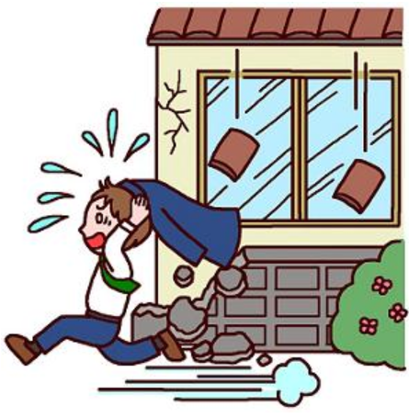
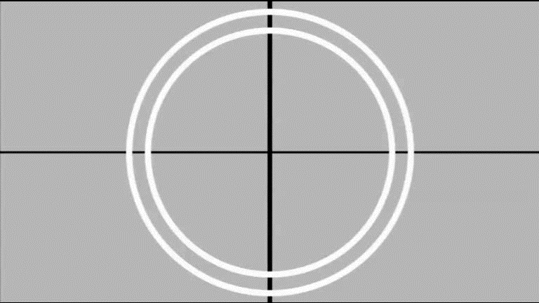
What would you do if you had only seconds to save your loved ones?
Que harias si solo tuvieras segundos para salvaguardar a tus seres queridos?
EQ Warning Decision
Control automated processes
Stabilize a surgery patient
Pause a Lasik eye-laser
Move away from a stove
Stop a car on road side
Shut off a gas valve
Halt an escalator
Drop-cover-hold
0
1
2
3
4
5
6
7
8
Time, Seconds
5
Notes:
Mostly, you can take a shelter within 4 second from the alert, and if you are on the road stop on the shoulder within 8 seconds or less.

Slide 6
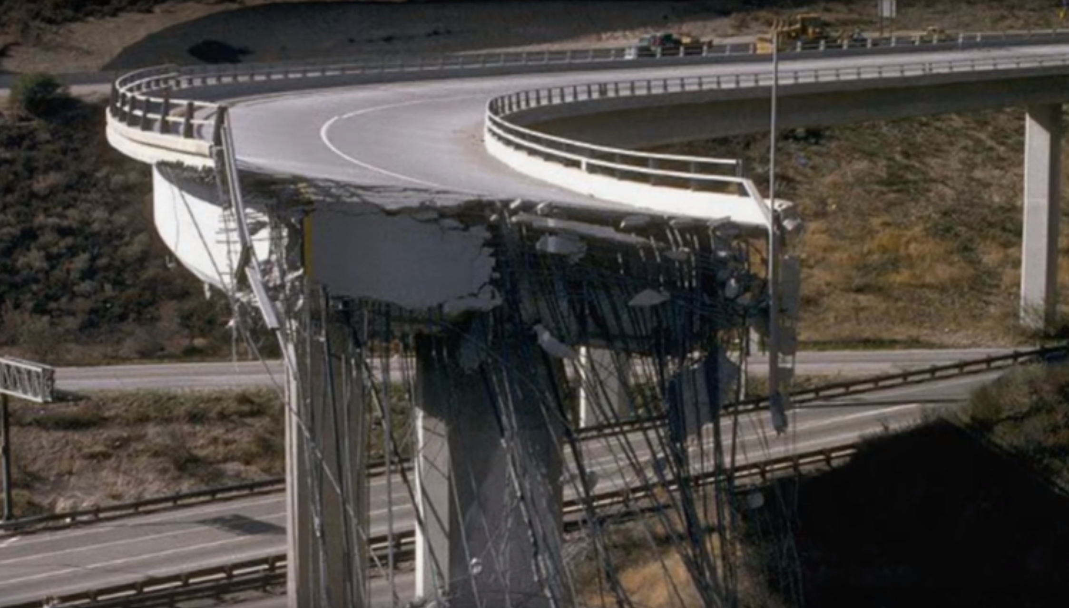
Driving on the highway…
You would definitely want to hit the brakes!

Slide 7
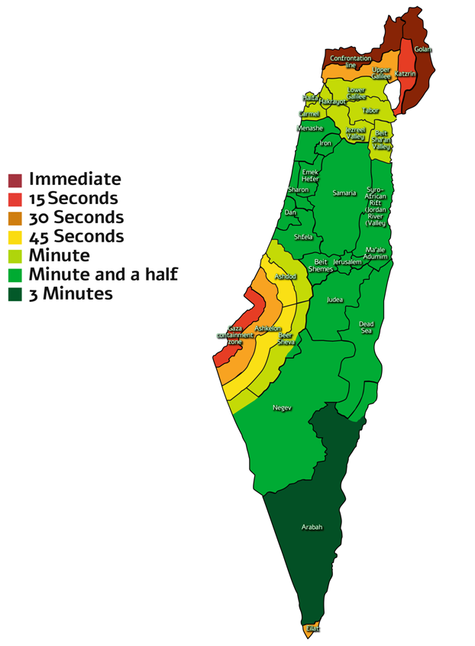
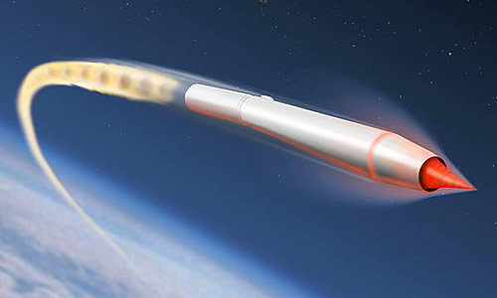
Problem Statement – Speed!
Defense analysts believe the missile has a range of 9,320 miles and could travel at 25 times the speed of sound.
https://www.businessinsider.com/china-unveils-dongfeng-41-nuclear-ready-missile-threaten-us-2019-10
Notes:
Another issue that cause us to look carefully at the speed of warning is the man-made hazards. [click]
Just last month we heard about the hypersonic missiles, that can travel at 25 times the speed of sound.
[click] and if it is not enough, look at the map of the state of Israel that is hit quite often by mom-and-pop slow rockets, and how fast a rocket can land in there.

Slide 8
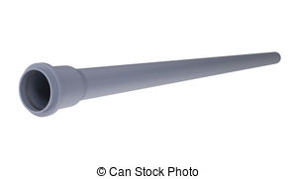
Why current system is slow?
Emergency Alert Systems are BROADCAST systems
Today’s systems are built on various implementations of http protocol.
HTTP protocol is one to one (not broadcast!) communications mechanism:
  Client periodically approach the server, ask for new information
  Server send the new info to the client
  Client digest the info and act accordingly
This is true for all clients in the system – multiply the load accordingly.
http
Alert
Server
Recipient
Recipient
Recipient
Notes:
Now why current system is slow?
Remember that emergency alert systems are BROADCAST systems, that means “from one point you broadcast alert to many many people”.
[Click] Today’s systems are built on various implementations of the http protocol. That is the internet protocol that we use when we browse for information on the web.
[Click] http protocol is one to one (not broadcast) communications mechanism.
Client periodically approach the server, ask for new information. Then the server send the information to the client that digest this info and act accordingly.
[click] And this is true for all clients in the system – multiply the load accordingly.
[click] As you can see in this illustration, all connections require http access from the recipient to the server, and the mass traffic can easily block the pipe.

Slide 9
Why MQTT make it faster (and easier)?
MQTT is a broadcast, one to many, protocol.
Broadcast of only the relevant messages to users (subscription based)
Little overhead -> enables fast transmission
Various levels to confirm reception by the client, prevent multiple activations.
Keep-alive mechanism, and more.
100%
100%
Alert system logic
A lot of overhead needed in HTTP based systems is covered in the MQTT protocol
Alert system logic
MQTT based operating system
HTTP based operating system
Notes:
Why MQTT protocol makes a faster system?
[click] MQTT is a broadcast, one to many, protocol.
[click] the protocol broadcast only the relevant messages to users (subscription based)
[click] Little overhead enables fast transmission
[click] Various levels to confirm reception by the client, prevent multiple activations.
[click] Keep-alive mechanism and more.
[click] You can see in the diagram a simulation of how the use on MQTT make the alert system logic smaller as many required functions are already in the basic protocol and there is no need to handle them in the application software level.

Slide 10
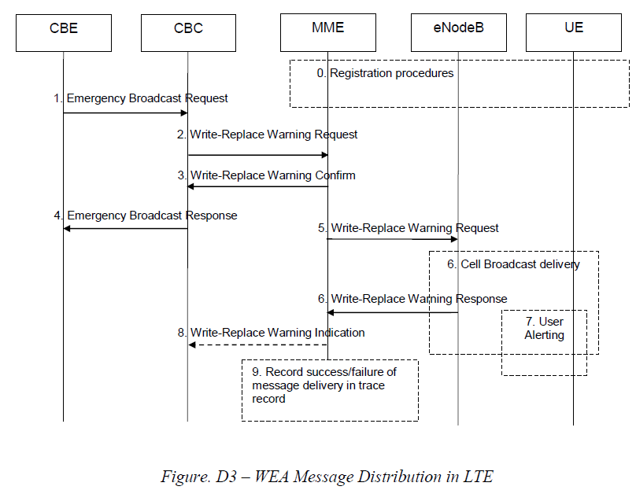
Is Cell Broadcast fast alerting?
IPAWS WEA is operational already for more than 7 years
FEMA concluded that no USA system can reach alerting time of 3 seconds!
Notes:
Everyone ask what about the cell broadcast? Is cell broadcast fast alerting?
Remember that in the US, the IPAWS wireless emergency alert system is operational already for more than 7 years with many activations.
Yet FEMA concluded that no USA system can reach alerting time of 3 seconds or less, which is considered as the benchmark for a fast alerting system.
[click] you can see here in the cell broadcast process that in the road to the cell broadcast delivery gateway there are many many steps that take time. The last step – the actual cell broadcast – is immediate but there are quite a few steps required before, and this takes time.

Slide 11

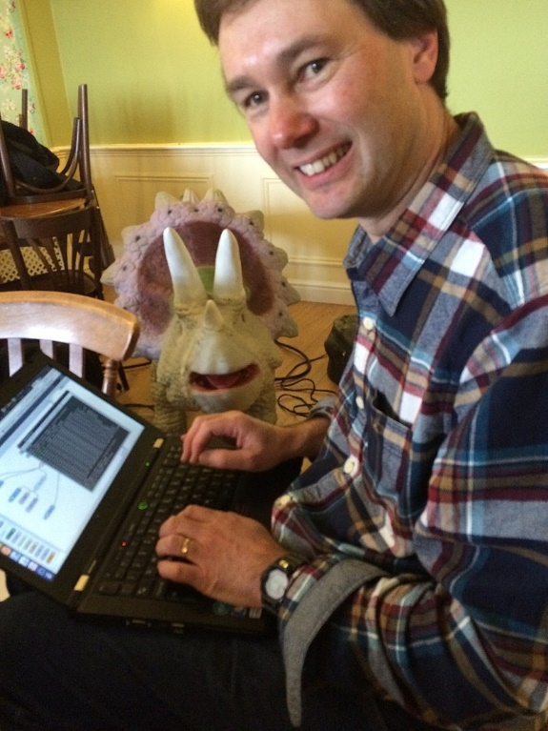
MQTT for fast alerting
Facebook Messenger said:
  “By maintaining an MQTT connection … we were able to often achieve phone-to-phone delivery in the hundreds of milliseconds, rather than multiple seconds.”
  https://www.facebook.com/notes/facebook-engineering/building-facebook-messenger/10150259350998920/
Amazon Web Services recently announced that Amazon Internet of Things (IoT) is based on MQTT, as well.
MQTT invention for Internet of Things
Invented in 1999 by by Andy Stanford-Clark (IBM) and Arlen Nipper (Arcom).
Notes:
The search for a fast alert system brought us to look at the MQTT. Many of us use the digital media on our phones, and the speed of this communications using these devices is amazing.
So we checked facebook messenger, and they say: “By maintaining an MQTT connection … we were able to often achieve phone-to-phone delivery in the hundreds of milliseconds, rather than multiple seconds.”
Similarly, Amazon web services is also a user of the MQTT protocol. So this protocol was selected by giants with armies of engineers – we cannot go bad.

Slide 12

02: Solution Overview - MQTT
Solution Overview : MQTT
Solution overview: CAP over MQTT
01
Problem statement: speed
02
03
04
05
Solution Benefits
Next Steps
Notes:
So after describing the problem that we are handling, it is time to present to you the proposed solution: MQTT protocol.

Slide 13
MQTT
Message Queue Telemetry Transport
Invented in 1999 by Andy Stanford-Clark (IBM) and Arlen Nipper (Arcom Control Systems).
They needed a reliable protocol for minimal battery loss and minimal bandwidth to connect with oil pipelines via satellite.
The protocol evolved to be used today for Internet of Things (IoT)
Notes:
MQTT stands for Message Queue Telemetry Transport.
It was invented 20 years ago by researchers from IBM and Arcom Control Systems.
They needed a reliable protocol for minimal battery loss and minimal bandwidth to connect with oil pipelines via satellite.
The protocol evolved to be used today for Internet of Things (IoT) and fast messaging.

Slide 14
MQTT is a messaging transport protocol
Protocol for use in constrained environments that require:
  A small code footprint to save battery
  The network bandwidth is at a premium and with unpredictable quality
  Handling intermittent connectivity
  High quality of Service data delivery
  Continuous session awareness
  Data payload can be of any type
Notes:
MQTT is a messaging transport protocol.
It is in use in constrained environments that require:
A small code footprint to save battery
The network bandwidth is at a premium and with unpredictable quality – which all of us face in cell communications or bad infrastructure.
Handling intermittent connectivity – again – moving cell phone in various areas.
High quality of Service data delivery is required – of course when we alert someone we do want the alert to reach its target
Continuous session awareness, to know that the other party is on, and if the communications drops to reconnect immediately when it is back on.
Data payload can be of any type – text, voice, video – any type can be the payload of the MQTT protocol.

Slide 15
MQTT Process
EQW for Mexico City
EQW for Mexico City
CLIENT
Recipient
Mexico City
Broker (server)
Client
Topic
Publish
CLIENT
CLIENT
BROKER
MQTT Server
Message
Ack
CLIENT
Publish
Runs the
Alerting
software
OK, thank you! You saved my life!
Ack
Source
Broker: accepts messages from clients and then delivers them to any interested clients.
Client: A “device” that either publishes a message, subscribe, or both.
Publish: sending a message to the broker.
Push based: no need to continuously look for updates
One-to-many architecture
CLIENT
Recipient
CLIENT
Acapulco
CLIENT
Notes:
Lets look at the MQTT concept. First we have a broker that runs the MQTT server software. And we have clients. Clients can be sources or recipients. Recipients can subscribe to alerts of their choice, and they do not need to periodically check for alerts – the system is push based, and the broker will send the alerts to all subscribers at the same time.
This client is the source in our system – it runs the alerting software. It could also run on the same physical machine the MQTT software.
Lets say it needs to sound the alert for Mexico City.
It published the alert to the broker, that acknowledge its receipt.
Then the broker sends the message to all of Mexico clients – and nothing is sent to the Acapulco clients.
Mexico clients receive the alert, act on it and acknowledge back to the server.

Slide 16
MQTT Concepts – Topics
house/room1/main-light
house/room1/alarm
house/garage/main-light
house/main-door
office/lobby
Etc.
Topic:
A namespace for messages on the broker, similar to computer directory.
Source clients publish to a topic, and
recipient clients subscribe to topics.
usa/california/contracosta
usa/california/alameda
usa/nevado/reno
Etc
Alert/cap/geo
usa/cap/met
usa/cap/safety
usa/cap/security
Etc
Notes:
How the alerts are ordered to make all this happen? That is where the TOPIC comes to play.
TOPIC is a name-place for messages on the broker, similar to computer directory. Alert sources publish into topics and recipient clients subscribe to topics.
We can see a few ways to arrange topics.
First one is for IoT control of a house, and second and third can be used for alert server.

Slide 17
MQTT Concepts – Subscription
I want to subscribe to topic: “alerts for Mexico City”
CLIENT Recipient
Mexico City
BROKER
Subscribe
CLIENT
Subscribe
Runs the
Alerting
software
Ack
OK, no problem
Subscribe:
A client tells the broker which topics interest it.
Once subscribed, the broker sends to this client the messages that are published to that topic.
A client can subscribe to multiple topics.
Ack
I want to subscribe to topic: “alerts for Acapulco”
Subscribe
Ack
CLIENT
Recipient
OK, you are on!
Acapulco
Notes:
How each recipient get registered to receive alerts that he is interested in? That is where the SUBSCRIPTION comes to paly.
A client tells the broker which topics interest it.
Once subscribed, the broker sends to this client the messages published to that topic.
A client can subscribe to multiple topics.
For example of the subscription model can be seen like that:
The client in Mexico City send a subscription request to the broker, telling it “I want to subscribe to the topic: alerts for Mexico City”. The broker add it to the list of Mexico City alerts and send back an acknowledge to the client.
Similarly, a client in Acapulco subscribe to alerts in his city.

Slide 18
MQTT Concepts - Connection
Persistent session – broker remembers what the client wants event when the client is off the network
CLIENT
MQTT Connection
Persistent session
Mexico City
BROKER
I just came back
CLIENT
I am alive
Yes, I remember you
Ack
Source
MQTT Connection – both sides keep the channel open and once in a while they have heartbeat
CLIENT
Acapulco
Notes:
We are almost at the end of explaining the MQTT protocol. I will talk about MQTT connection and Persistent session.
]click] MQTT Connection – both sides keep the channel open and once in a while they have heartbeat. For example, every minute or every hour, depends on system design, the client send a message “I am alive” and the broker responds “no problem, I am here for you”.
As for Persistent session:
[click] clients may loose their internet connection. Once they are connected again, all they need to do is tell the broker: I just came back”. And the broker, that remembers what the client wants, register it again. This way the communication is kept very minimal, short with minimal contents.

Slide 19
MQTT Concepts – Quality of Service
Quality of Services (QoS)
at most once (qos 0): best effort delivery (fire and forget).
at least once (qos 1): a message will be delivered at least once. But the message can also be delivered more than once (requires 2 messages).
exactly once (qos 2): guarantees that each message is received only once by the counterpart (requires 4 messages)
Each subscriber could have a different level of QoS

Slide 20
MQTT vs HTTP comparison
Features | MQTT | HTTP
Full Name | Message Queue Telemetry Transport | Hyper Text Transfer Protocol
Design Methodology | The protocol is data centric. | The protocol is document centric.
Architecture | It has publish/subscribe architecture. Here devices can publish any topics and can also subscribe for any topics for any updates. | It has request/response architecture.
Complexity | simple | more complex
Data security | YES (Payload Encrypted) | NO, hence HTTPS is used to provide data security.
message size | small, it is binary with 2Byte header. | Large, it is in ASCII format.
Service levels | 3 | 1
Data distribution | 1 to many | one to one only

Slide 21
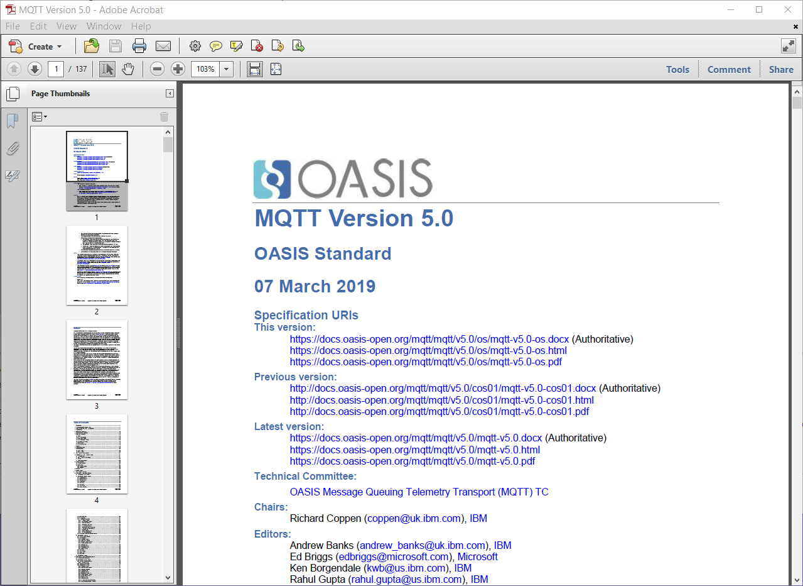
MQTT is an OASIS Standard

Slide 22

03: Solution overview – CAP over MQTT
Solution overview: CAP over MQTT
01
Problem statement: speed
02
Solution Overview : MQTT
03
04
05
Solution Benefits
Next Steps

Slide 23
Implementation of a
CAP over MQTT system
Alert Recipients
Broker
Alert Source
CAP xml as the payload of the MQTT message

Slide 24
One Implementation of a
CAP over MQTT system
Alert Recipients
Broker
Alert Source
MQTT client reads the CAP message and publish it to the broker:
Topics selected are based on the affected area such as: /alerts/location/guerrero/acapulco
In addition topics may include type of warning such as EQ warning topic.
MQTT client subscribes to the alert topic(s) of interest and sustain the connection.
State-wide subscription: /alerts/location/guerrero/#

Slide 25
Implementation of a
CAP over MQTT system
Alert Recipients
Broker
Alert Source
MQTT servers available
  Mosquito
  Axiros
  MQTTRoute
  HiveMQTT
  Solace
  MyQTT Hub
  And many more

Slide 26
Implementation of a
CAP over MQTT system
Brokers
Alert Source
Agency Alert Recipients
Other internal
modules
Intranet
Internet
Public Alert Recipients

Slide 27
04: Solution Benefits
Solution overview: CAP over MQTT
01
Problem statement: speed
02
Solution Overview : MQTT
03
04
05
Solution Benefits
Next Steps
Notes:
© Copyright PresentationGO.com – The free PowerPoint and Google Slides template library

Slide 28
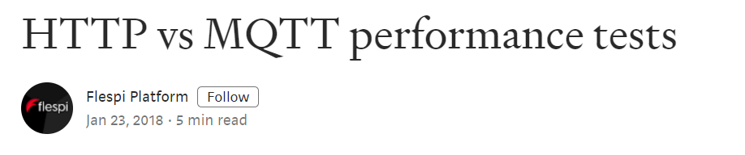
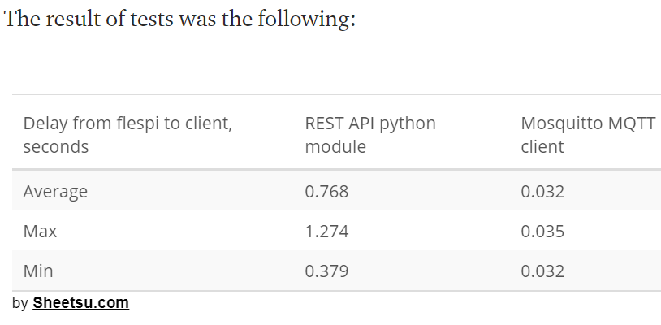
Speed of alert
Even for the fastest case in the http test, the MQTT is x10 faster in its Max case.
MQTT can be x100 speedier than http

Slide 29
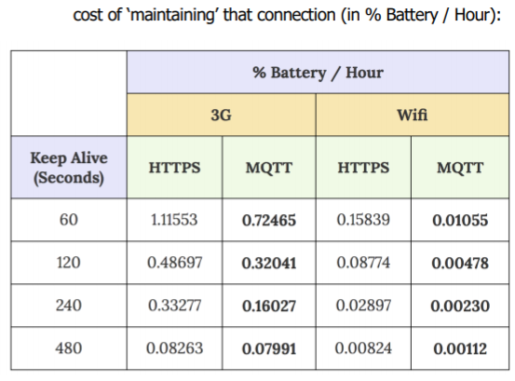
Battery saving in Mobile
MQTT use 65% of the HTTPS battery consumption for cellular (60 sec keep-alive)
MQTT use 6% of the HTTPS battery consumption for WiFi (60 sec keep-alive)

Slide 30
Other benefits
Simpler implementation as many required functions are already included in the protocol
Persistent session by MQ, requires only 2 bits periodic bits
MQ can ensure delivery (at protocol level) with three QoS
One to many protocol, less complicated server
Subscription is similar to a VHF radio system, no need for administrator or computer access.
All clients can subscribe (receive), and publish (feedback).
A system can include a few MQTT brokers for various users and various topics
Reducing the receiver load and chances for ewrror by sending him only relevant messages.
Built-in first layer of security (name/password), payload can be encrypted.

Slide 31
05: Next Steps
Solution overview: CAP over MQTT
01
Problem statement: speed
02
Solution Overview : MQTT
03
04
05
Solution Benefits
Next Steps
Notes:
© Copyright PresentationGO.com – The free PowerPoint and Google Slides template library

Slide 32
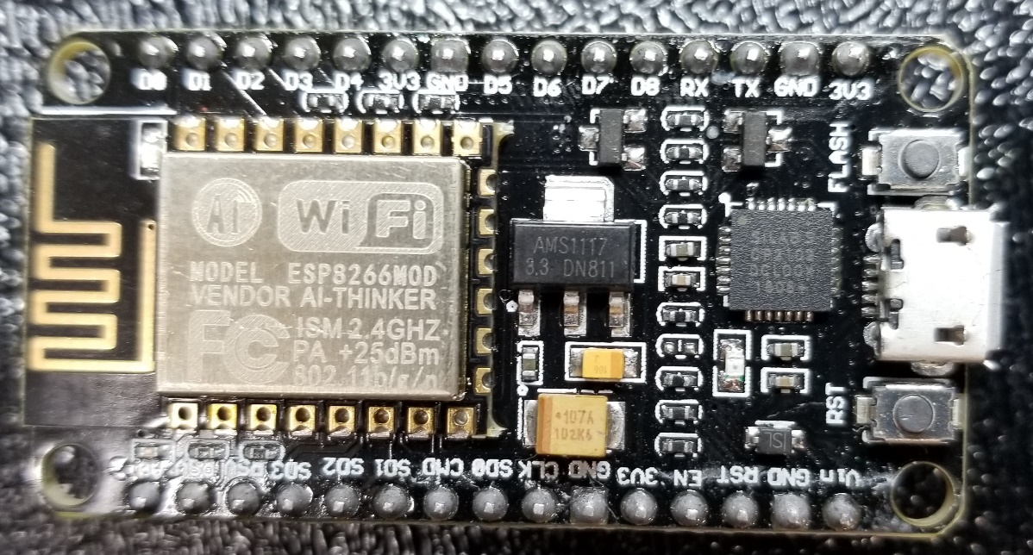
Use MQTT
Include in your CAP design project MQTT:
  Get one of the many free servers, or start by using Amazon free server
  You can “play” with a simple end-user receiver using available hardware and simple programming:
    ESP8266MOD – a Wi-Fi MQTT receiver on a chip

Slide 33
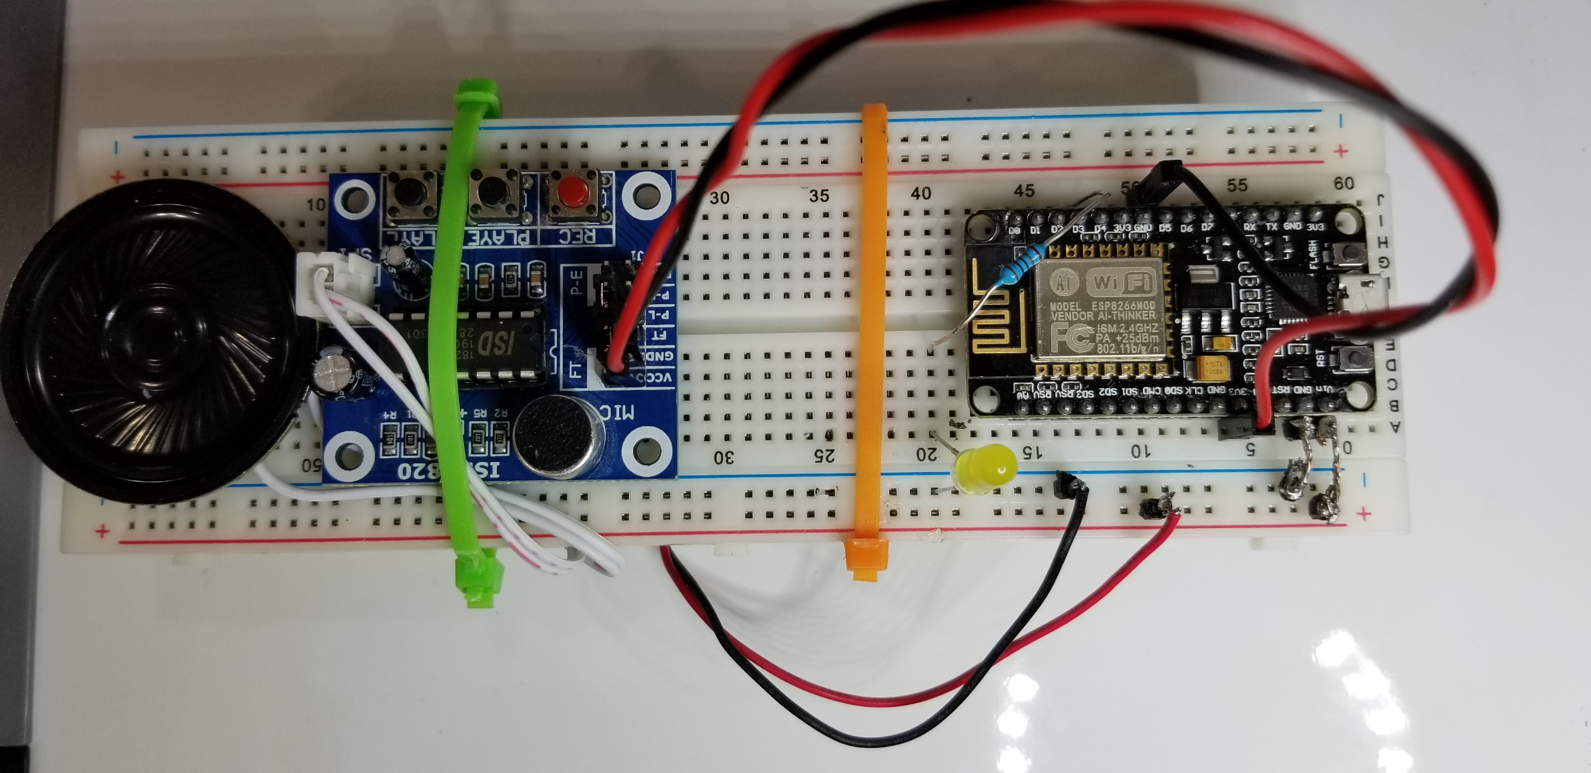
Photo of a receiver prototype

Slide 34

For further information:
Efraim Petel
efraimp@gmail.com

