Slide 1

Resilience as a Service
PRESENTATION
CAP as the foundation for Situational Intelligence
elysajones@yahoo.comSeptember 2015
Notes:
Need copyright and company info on each slide.

Slide 2
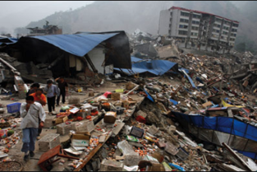

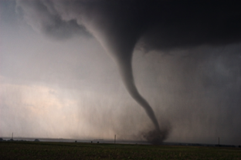
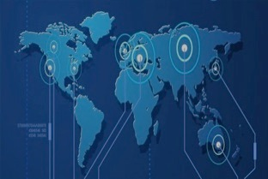

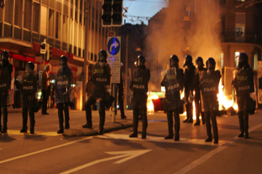
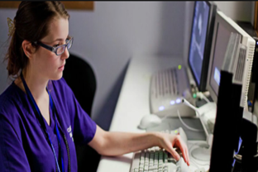

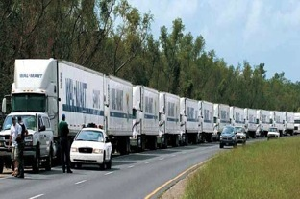
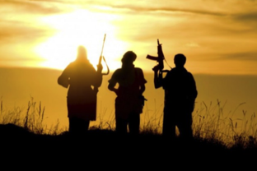
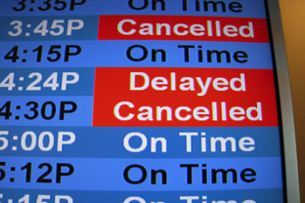
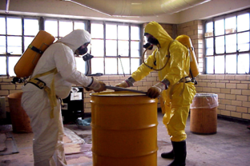
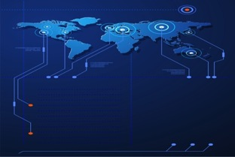
Planet Earth is a high-risk environment. New catastrophes can be expected to emerge.
Natural Disasters
Crime
Severe Weather
Cyber Threats
Brand Tarnishing
Civil Unrest
Disease
Blackouts
Supply Chain Disruption
Terrorism
Travel Disruption & Delays
Hazardous Materials
2

Slide 3
Next Generation Resilience
The organizations that will respond best to next emergency are those whose people are prepared, informed and vigilant—and whose operations are agile, sustainable and connected (even in a crisis).
Improving your organization’s resilience requires more than just hardening perimeters and increasing security protection….
It also requires the best, latest, real-time intelligence—using a public/private information sharing model that can keep your security teams informed about breaking events and current conditions, while also making it easy and safe to share intelligence with employees, government agencies and partners.

Slide 4
Resilience leverage points
All hazards
Info exchange between organizations
“Network of networks”
Interoperable data standards
High assurance security
Agile, rapid response to incidents
Scalable and extendable

Slide 5
Swan Island joins forces with Microsoft
In 2014, Swan Island announced a partnership with Microsoft, joining its CityNext “Smart City” initiative. Together we launched TIES® for Microsoft CityNext, a threat intelligence service for use in Smart City environments—and have presented together at multiple events around the world.
© 2015 Swan Island Networks -- Confidential

Slide 6

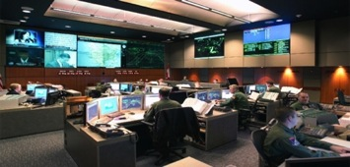
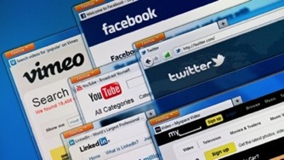
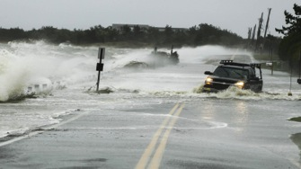
The New Agile Intelligence Paradigm
Secure & reliable cloud-based networking
Physical and cyber intelligence channels
Easy-to-use, customizable dashboards
In-depth channel filtering & synthesis
Smart Alerting & social media monitoring
Mobile notifications & field reporting
Networked video & GPS monitoring
Supporting Communities of Trust from 5 to 500k

Slide 7
TX360 Differentiators
Ease of use – no training for information consumers,
Rapid response to new threats and incidents
“All Hazards” approach covers physical/cyber
Community of Trust/Cross Organizational sharing
Validated network members to insure security/trust
Extendable – integrates other solutions, avoiding a proprietary environment and a myriad of interfaces
Flexible licensing model allows branding control and surge (pay what you use) licensing
Cloud based – scalable and redundant globally

Slide 8

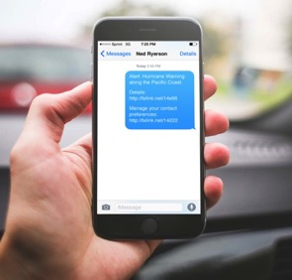
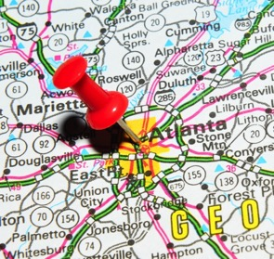

TX360®
Connect. Share. Protect.
®
1
Intelligence Channels
Gather late-breaking intelligence from an expansive gallery of highly filtered, trusted sources or import and manipulate your own feeds.
2
Smart Alerts
Deliver only relevant alerts and updates to concerned parties, tailored to each recipient’s authorization, preference and profile.
3
Dashboards
Monitor relevant threats in real-time on a common operating picture dashboard. Determine an incident’s proximity to your assets.
4
Secure Communities
Create trusted networks of alert recipients and collaborators to share sensitive information within and across organizations.

Slide 9
CAP and TX360
Supported since 2004
Consumed millions of CAP alerts
Broadcast targeted and filtered results – avoiding information overload
Can be mixed with other geospatial feeds (GEO-RSS, Twitter, GPS tracking)
Internal CAP alerts can be integrated to augment public alerting

Slide 10




Using TX360
PUBLIC INFO
CHANNELS
PRIVATE INFO
CHANNELS
PREMIUM
CHANNELS
TX360
SMART ALERT
CREATION
DASHBOARD CREATION
ACCESS
CONTROLS
COLLABORATIVE
WORKSPACES
DASHBOARDS
& SMART ALERTS
SMART ALERTS
USER GROUPS
(Trusted Individuals)
SUBSCRIBERS
(outsiders)

Slide 11
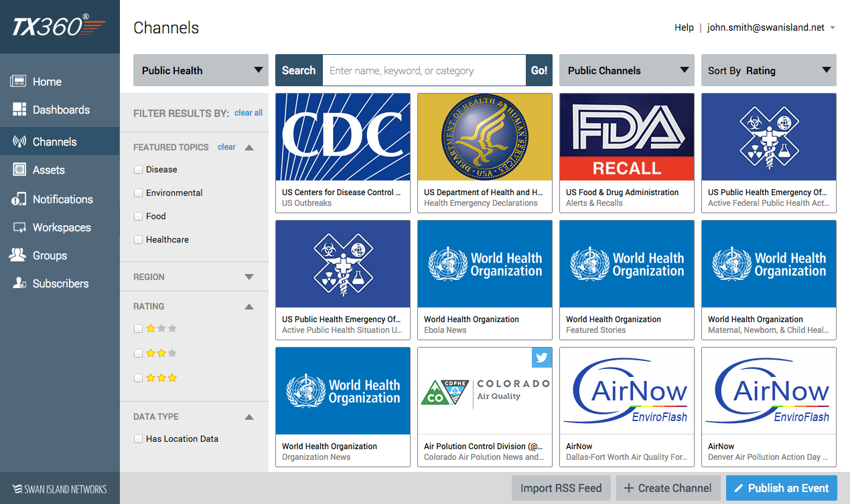
Intelligence Channel Gallery

Slide 12
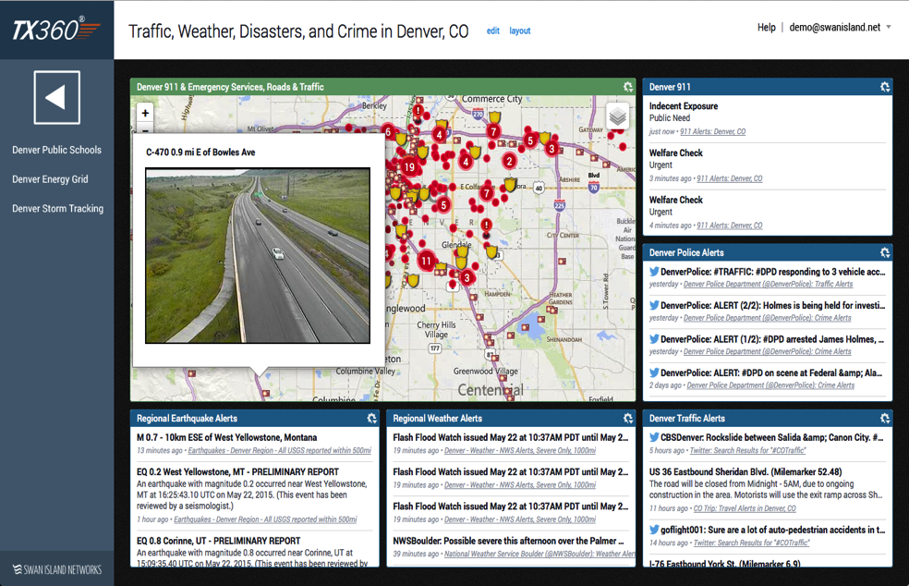
“Common Operating Picture” Dashboards
PRIVATE AND
PUBLIC ASSETS
LOCAL 911 FEEDS
VIDEO FEEDS
AMBER ALERTS
NATURAL DISASTERS
SOCIAL MEDIA MONITORING
SEVERE WEATHER
LOCAL NEWS FEEDS

Slide 13

THANK YOU
elysajones@yahoo.comSeptember 2015

