Slide 1
EARLY WARNING SYSTEM OF THE MEXICO CITY (Common Alert Protocol)

Slide 2
Number of Emergencies Registered in the Cit
Percent Distribution of Registered Emergencies in the City
Type of phenomenon | Quantity
Geological | 450
Hydrometeorological | 1,434
Technological Chemist | 3,871
Ecological Sanitary | 100
Socio-organizational | 4,589
Total | 10,444
Notes:
Due to its geographical location, Mexico City is exposed to various disturbing phenomena of natural and anthropogenic origin, so it is necessary to have tools that help the population to carry out self-protection actions. Between January 2018 and July 2019, there have been more than 10 thousand emergencies in the city, of which at least 80% could be alerted in advance, which would undoubtedly have been reflected in a reduction in the affected population, damage and los

Slide 3
The Alert System is promoted through information and communication technologies. This must be clear and timely based on knowledge of the risk and monitoring of the potential danger, taking into account:
1.- The previous knowledge of the risk for which the alert will be made, based on the Atlas of Dangers and Risks of Mexico City, which includes the analysis and evaluation of the characteristics of the disturbing phenomenon, such as intensity, probability of occurrence, vulnerabilities, identification of geographical areas and communities that could be affected.
2.- The equipment for measuring, monitoring, transmission, acquisition and processing of the information that is required, as well as the systems to disseminate alerts.
3.- The dissemination and communication mechanisms to disseminate alerts to the population at risk and to the authorities.
4.- Actions and procedures to optimize an adequate response to alerts.

Slide 4
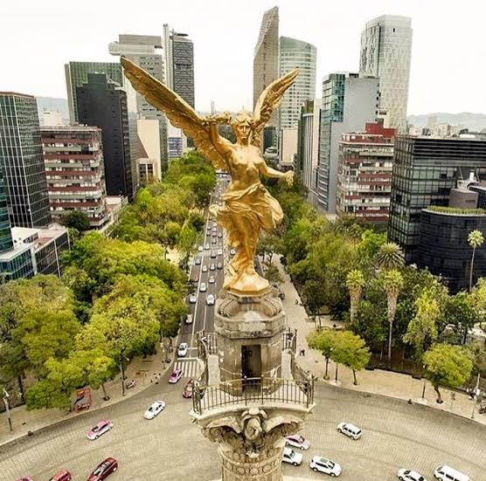
EARLY WARNING SYSTEM OF THE MEXICO CITY
The population of Mexico City has an Early Warning System.
This is defined as a set of elements that provides timely and effective information, allowing individuals exposed to a threat to take actions to avoid or reduce their risk, as well as prepare for an effective response.

Slide 5
Components of Early Warning Systems
Risk Knowledge
Atlas of City Risks
Phenomenon monitoring
CIRES
Answer's capacity
Dissemination of Alerts
Radio
C5
TV
Speakers
Social Network
Training Communication strategy Action Protocols
CAP
SACMEX
CENAPRED
Atlas of City Hall
Risks Specific studies
Notes:
Early Warning systems are composed of four fundamental elements, which we are integrating into the Mexico City Alert System.
Regarding the knowledge of the risks, we have a Risk Atlas that allows us to know the areas of greatest impact on the impact of the different phenomena, but also the levels of vulnerability of the exposed systems. In the area of ​​monitoring of phenomena, the City Government has a wide network of monitoring of various phenomena, through CIRES the areas in which the highest incidence of earthquakes are recorded are implemented, SACMEX monitors the conditions of the hydraulic infrastructure of the city and has a Meteorological Radar that allows more accurate forecasts of hydrometeorological phenomena. For the issue of landslide, we are about to launch a pilot program in which four hillsides will be implemented in which there is a population settled in the West of the City. On the issue of dissemination of alerts, there is infrastructure such as speakers installed throughout the city, screens that are located in the main roads and in the metrobus, social networks, receivers installed in public, private buildings and schools, and even some radio and television stations. Although in most of these media at the moment they only spread the seismic alert, it is thought that for the next year they will begin to receive other types of Alerts.
Finally, on the issue of responsiveness, we are training the population to know how to act before, during and after the impact of a phenomenon, but above all, how to act when listening to the alert. It is of no use all the technology that is available, if the population that receives the alerts does not know how to react, the alert must be transformed into concrete actions aimed at safeguarding the life and property of the population.

Slide 6
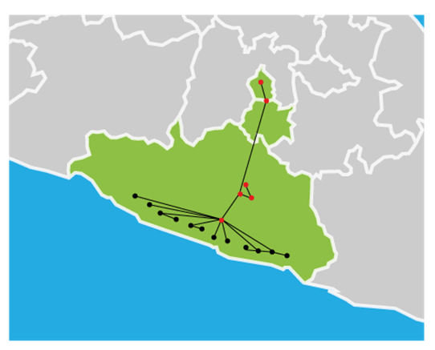
MEXICAN SEISMIC ALERT SYSTEM
After the earthquakes of September 19, 1985, local government authorities with the Center for Instrumentation and Seismic Registration, A.C. (CIRES), installed a network of 78 seismometers in Mexico City to monitor telluric movements from the seismic gap of Guerrero.
Ciudad de México
Morelos
Guerrero

Slide 7
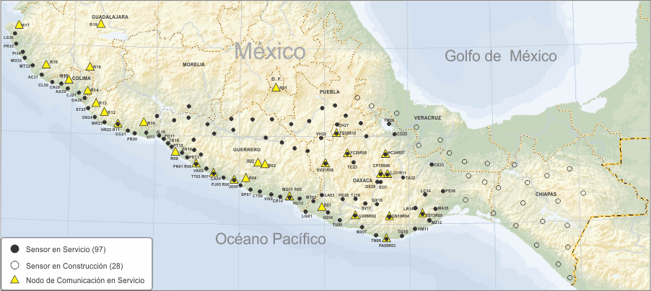
MEXICAN SEISMIC ALERT SYSTEM
The Mexico City Seismic Alert System aims to notify the proximity of a telluric movement that could put the population and physical infrastructure of the city at risk. This system monitors day and night the occurrence of earthquakes in the coastal regions of Jalisco, Colima, Michoacán, Guerrero, Oaxaca and Puebla.

Slide 8
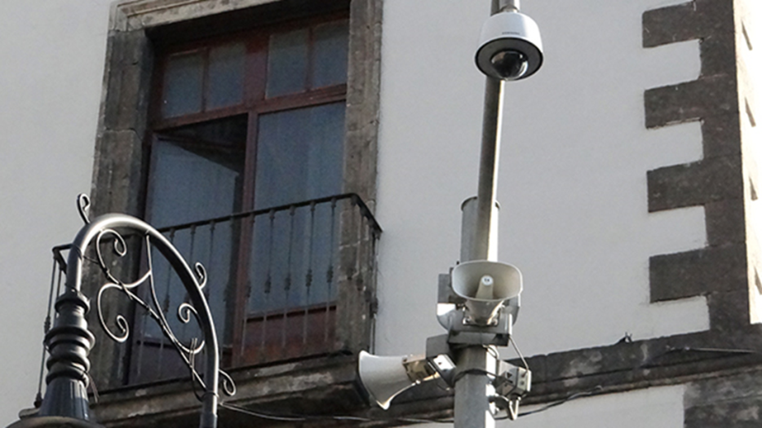
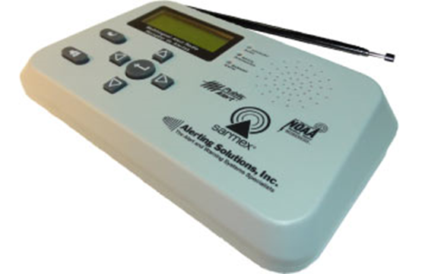
MEXICAN SEISMIC ALERT SYSTEM
The seismic alert can be identified through the speakers of the city's video surveillance cameras, or the radio receivers installed in public and private buildings or schools.
The seismic alert is activated when an earthquake of significant magnitude occurs in the region covered with the SASMEX sensors, in the states of Jalisco, Colima, Michoacán, Guerrero, Oaxaca and Puebla, also when two or more nearby sensors confirm that the magnitude of the Earthquake can cause damage.

Slide 9
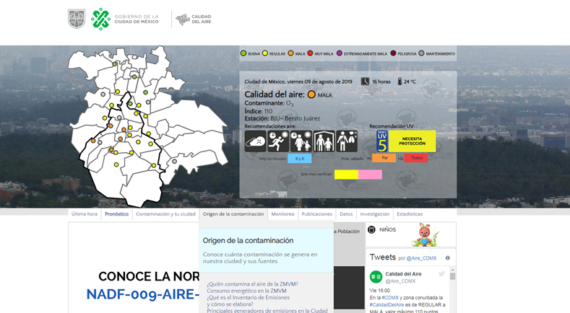
Air quality
The monitoring is carried out by the Ministry of Environment of the Government of Mexico City, it serves to report on the deterioration of air quality due to the presence of polluting substances, as well as prolonged exposure to solar radiation, which has negative effects in health and in the environment.

Slide 10
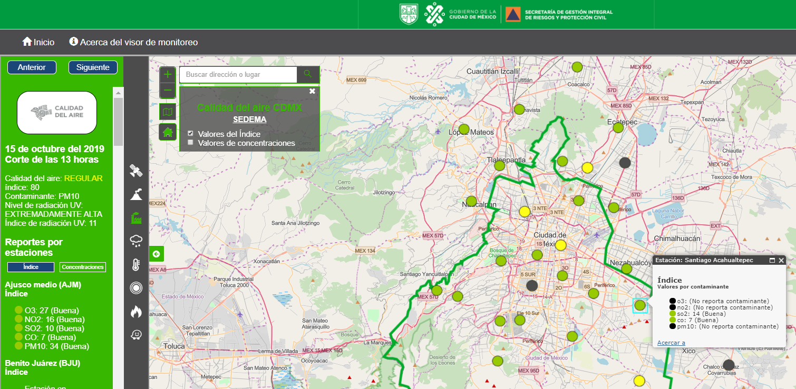
The SEDEMA authorities have 45 air quality monitoring stations that make up the Atmospheric Monitoring System, are located in the CDMX and in the EDOMEX.

Slide 11
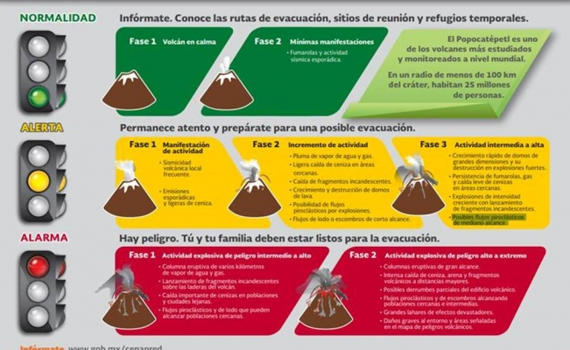
The Popocatepetl volcano is monitored 24 hours a day by the National Center for Disaster Prevention and it is through the Volcanic Traffic Light that the population of Mexico City, and neighboring states, is informed about the state it is keeping.
The volcanic traffic light is divided into three phases and colors: green, yellow and red.

Slide 12
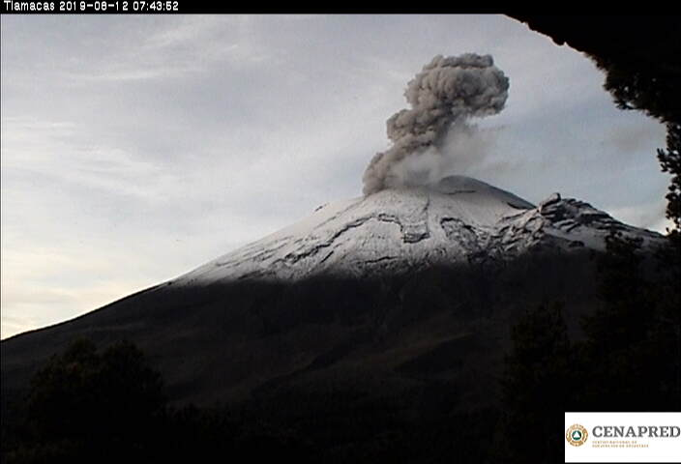

Slide 13
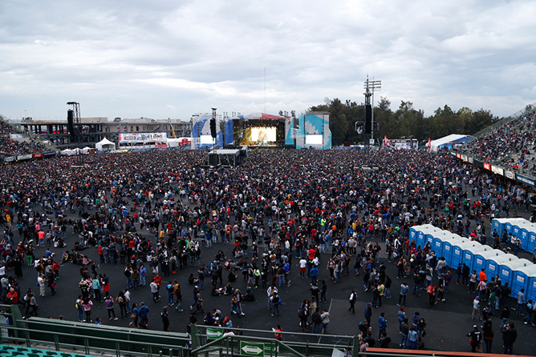
The warnings and notifications provided by the Integral Risk Management and Civil Protection authorities during mass events are also being integrated into the Early Warning System of Mexico City. As well as the alerts issued by the authorities of the Mexican Health System.

Slide 14
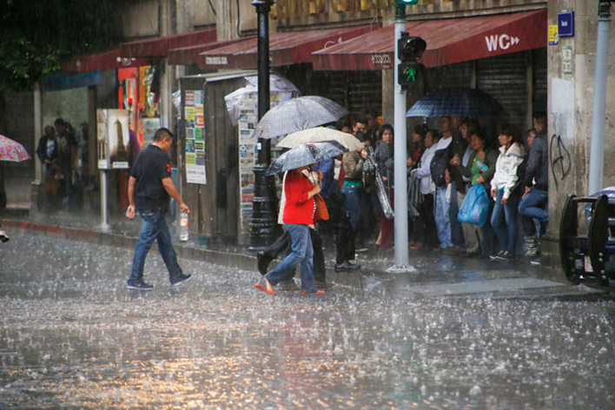
Alerta Temprana por Tiempo Severo
The Early Warning for Severe Weather aims are to inform the population about the presence of heavy rains, wind, hail, snowfall or snow water, as well as high or low temperatures. This weather alert has a colored traffic light to indicate the magnitude and estimated time of the onset of the phenomenon and so people can prepare.

Slide 15
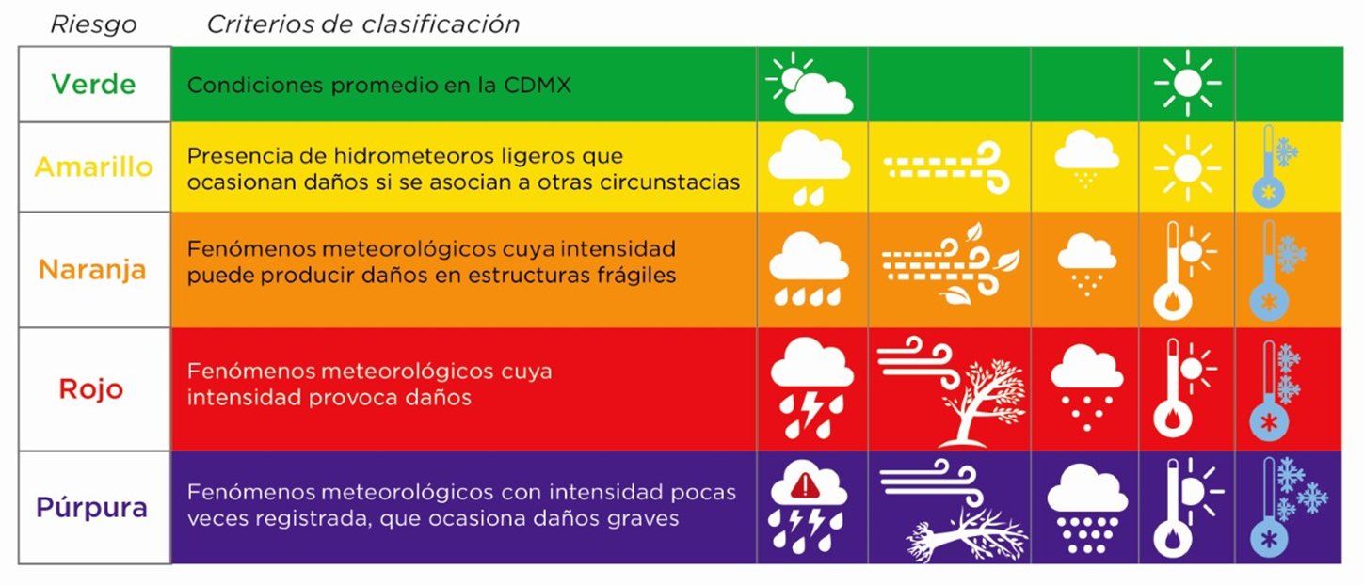
Traffic Light Early Warning for Severe Weather

Slide 16
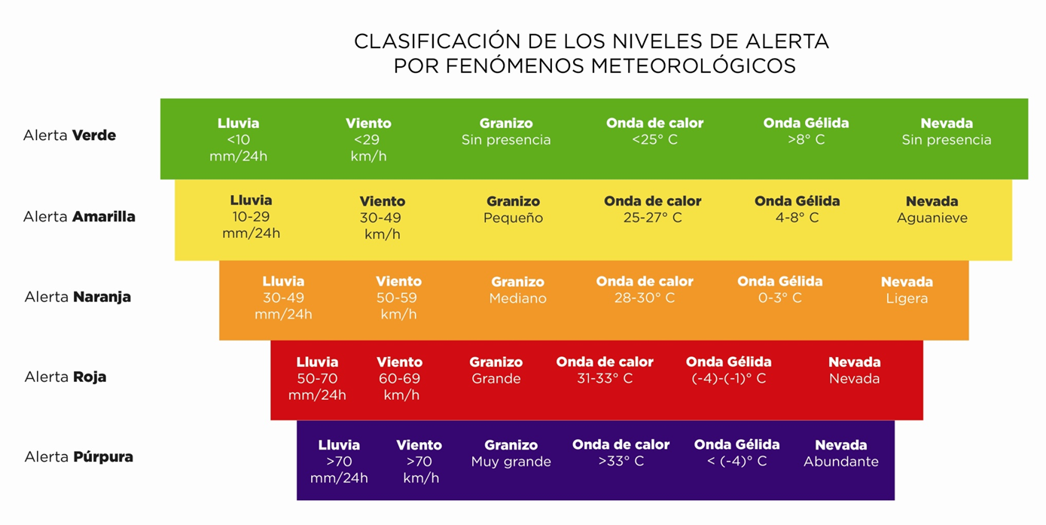
It is divided into 5 levels by intensity of risk; for rains, winds, hail fall, high, low and snowy temperatures.

Slide 17
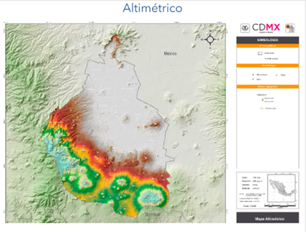
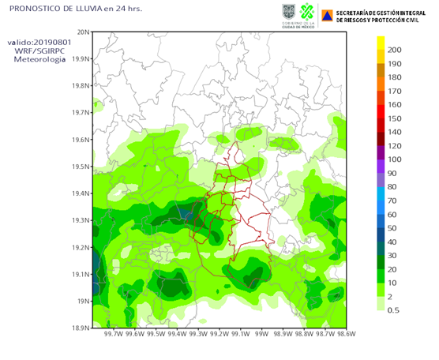
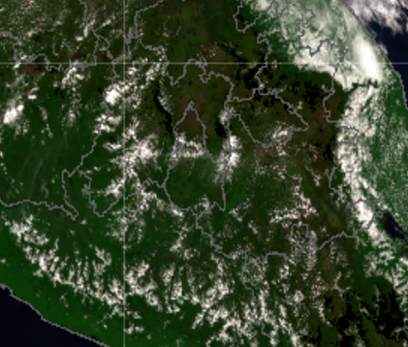
Alerta Temprana por Tiempo Severo
The areas of greater and lesser risk are evaluated in accordance with the provisions of the Atlas of Dangers and Risks of Mexico City.
Data on temperature, direction and wind speed, humidity, as well as meteorological satellite and radar images for rain detection are collected.
Computational models solve physical-mathematical equations to obtain short-term forecasts.

Slide 18
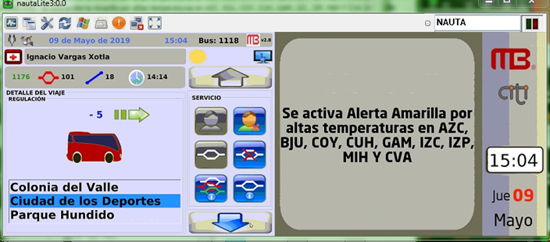
MECHANISMS OF DISSEMINATION OF ALERTS
Currently the alert is spread to the population through newsletters for the media, directly through social networks, through the speakers of the C5 cameras, through the available spaces of the city government such as:
-Mubibus screens

Slide 19
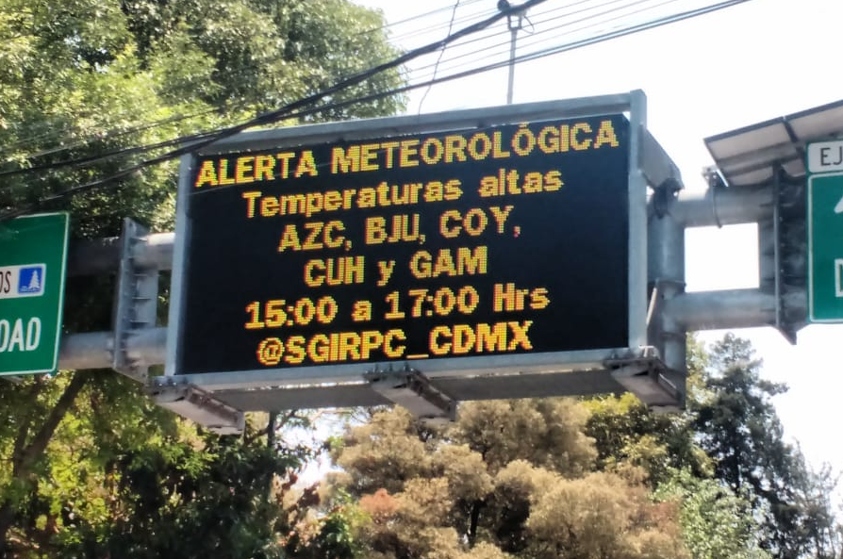
Screens located in the main roads of Mexico City, belonging to the Secretariat of Works and Services of the CDMX.

Slide 20
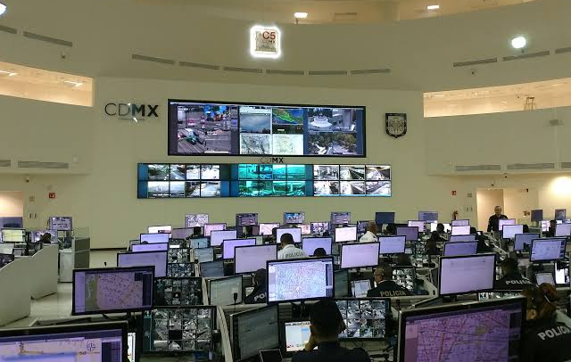
There is dissemination through social networks and coordination through WhatsApp and email groups with authorities of the central, federal and 16 Municipal Governments, which allow the establishment of coordinated action protocols, as well as 24-hour surveillance and attention of the day.
C5 CDMX image

Slide 21
Image of an alert.

Slide 22
Warning image for the CDMX.

Slide 23
Image of the Popocatépetl volcano activity report

Slide 24
Final thoughts
The Common Alerting Protocol allows clear and precise information to be sent to people who are at risk so that they have the opportunity to protect themselves.
In emergency situations, short, standardized and regionalized messages are required to make the alert effective communication.
There is no point in an early warning if the population does not know how to act when they receive it. Therefore, strengthening the response capacity is essential.
Alerts should only reach people for whom the phenomenon represents a hazard.

