Slide 1
CAP implementation The role of ITU
CAP Implementation Workshop, 31 October – 1 November 2018, Hong Kong
Vanessa Gray
Head, Least Developed Countries, Small Island Developing States & Emergency Telecommunications
Telecommunication Development Bureau, ITU

Slide 2
ITU: Committed to help the world communicate
193
800
MEMBER STATES
SECTOR
MEMBERS & ADADEMIA
ITU-T X.1303
Each sector has specific mandate, but all work cohesively towards connecting the world
… and to help achieve the Sustainable Development Goals through the use of ICTs

Slide 3
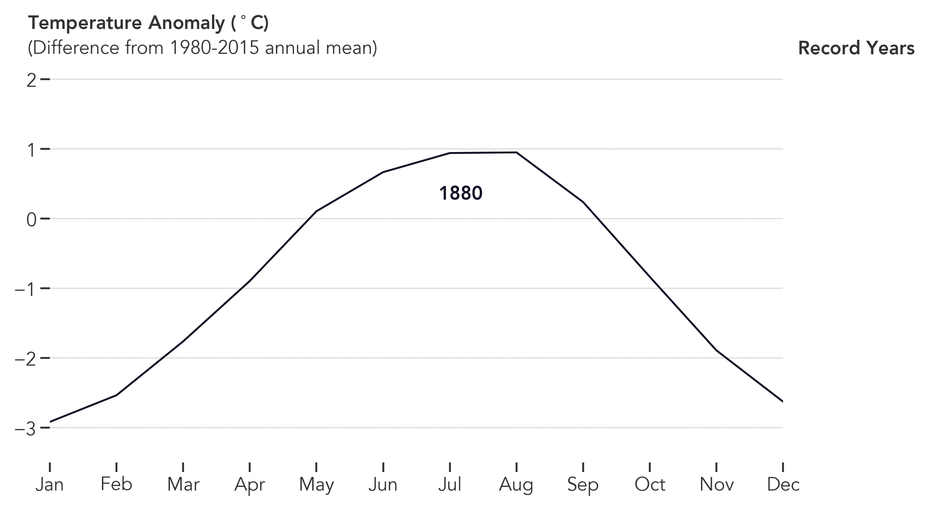
2017 WAS THE SECOND HOTTEST YEAR ON RECORD
Source: NASA Earth Observatory

Slide 4
Emergency telecommunications matter … more than ever
Disasters have devastating effects on peoples’ lives
Climate change makes things worse
ICTs offer ever growing opportunities to predict, to track, to warn and to save lives: More people are part of the growing information society (covered by a mobile network, using the Internet etc.)

Slide 5
SAVING LIVES
Use ICTs to for alerting, and to increase disaster resilience
Raise awareness in the use of ICT for disaster response and mitigation
Promote the implementation of early warning systems
Support countries in the preparation of national disaster response in the areas of regulation, policy and to develop national emergency telecommunication plans
Carry out research and identify new technologies, trends, best practices

Slide 6
Report on Disruptive Technologies for Disaster Management
ICT development/trends: 5G, AI, IoT, big data, robotics, drone technology
Case studies: Opportunities & benefits
Challenges, relevance and sustainability
Recommendations

Slide 7
Global Guidelines on National Emergency Telecommunication Plans
Purpose:
Better coordination for disaster management
Processes/procedures to identify national needs
Framework for national consultation and cooperation
Multi-stakeholder roles and responsibilities
Implementation of policy/legislation requirements
CAP as best practice
Structure of Guidelines:
Topology of disasters
Phases of disaster management
International cooperation and coordination
National disaster management
Telecommunications/ICTs for disaster management
ICT legislation and regulation
Capacity development and drills
Support for people with disabilities
NETP: step by step guide

Slide 8
Re-CAP: ITU & CAP
Awareness raising & capacity building
Capacity building workshops & training
Emergency telecommunication/disaster management events
Guidelines on national emergency telecommunication plans
Better coordination with ICT community
Through ITU Membership: Telecommunication/ICT policy makers, regulators, private sector
ITU Study Group Question 5/2: Utilization of telecommunications/ICTs for disaster preparedness, mitigation and response
Monitoring progress in CAP implementation

Slide 9
GLOBAL FORUM ON EMERGENCY TELECOMMUNICATIONS
Join us for GET-19!
Mauritius, 4-6 March 2019
Disaster risk reduction strategies
National emergency telecommunication planning and policies
Resilient infrastructure
National coordination
Early-warning and monitoring systems
Emerging technologies and innovations

