Slide 1

CAP Implementation Workshop 2017
WMO Global Multi-hazard Alert System
WWIS & SWIC as platforms to disseminate weather warnings in CAP
20-21 Sep 2017

Slide 2
WMO Global Multi-hazard Alert System (GMAS)
Decision 3.2(1)/1 (EC-69) on GMAS
Vision
  Recognized globally by decision makers as authoritative warnings and information related to high-impact weather, water, ocean and climate events
Rational
  Sendai framework – NMHSs and WMO agreed to do more to enhance services, strengthen regional and global collaboration to support Multi-Hazard Early Warning System (MHEWS)
  To make warning information from all countries more easily available for decision makers

Slide 3
WMO Global Multi-hazard Alert System (GMAS)
Rational (Cont’d)
  Share vital lessons learnt by NMHSs in delivering vital multi-hazard services with global DRR community
  Strengthen NMHSs as official authoritative source
  Ensure global community receives the multi-hazard information from authoritative source
  Ensure complex hydrometeorological language is translated into information which can be “actioned” by decision makers

Slide 4
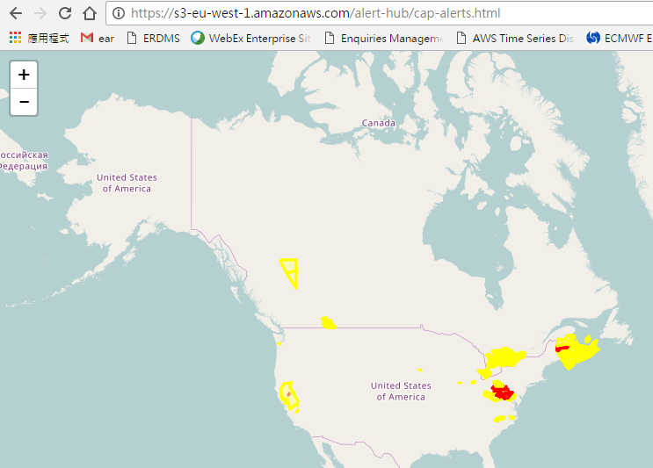
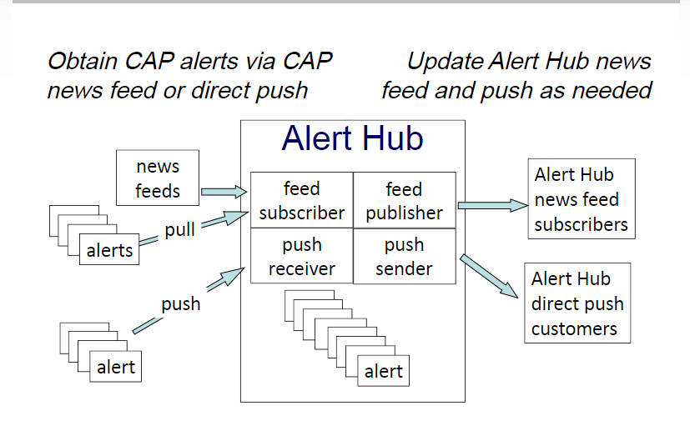
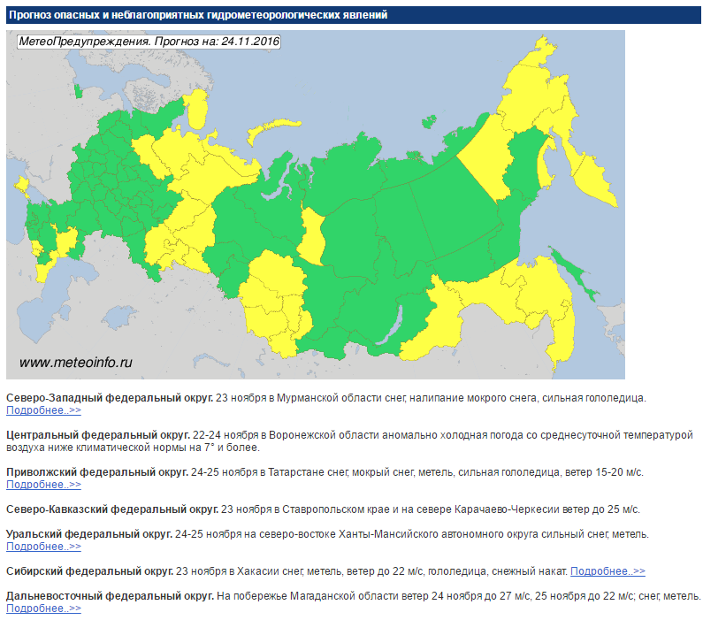
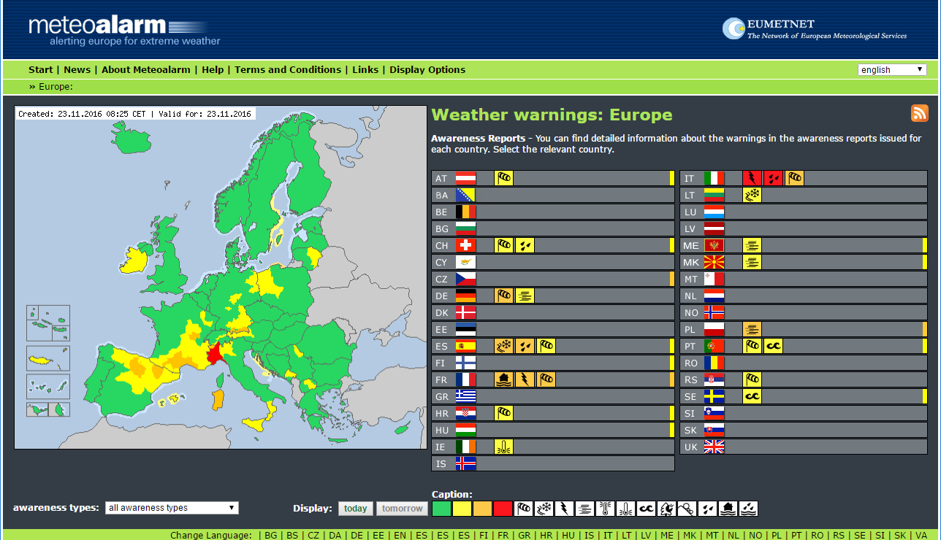
WMO Alert Hub
WMO working with NOAA to develop an alert hub for free service to all alerts from Members (Partners: Open Commons Consortium, Amazon Web Services, IBM/TWC, Hong Kong Observatory, Honeycomb Networks)
Hub to provide one-stop platform for alerts issued by authorized agencies/institutions
Prototypes developed
Courtesy: Eliot Christian
Other WMO Systems featuring Warnings

Slide 5
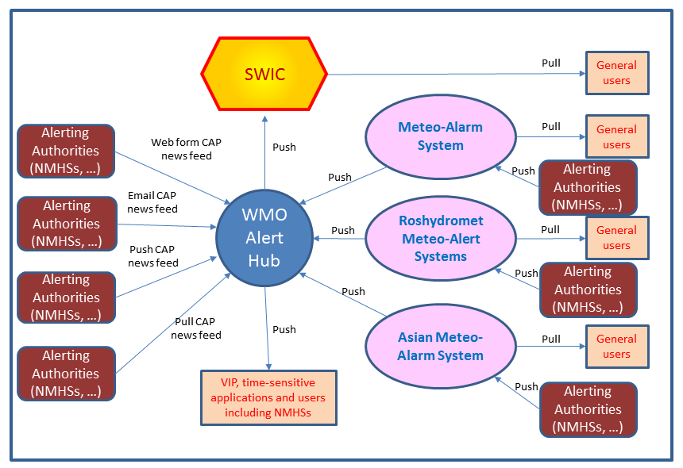
An Initial Idea
GMAS Inter-regional
Display of Warnings

Slide 6
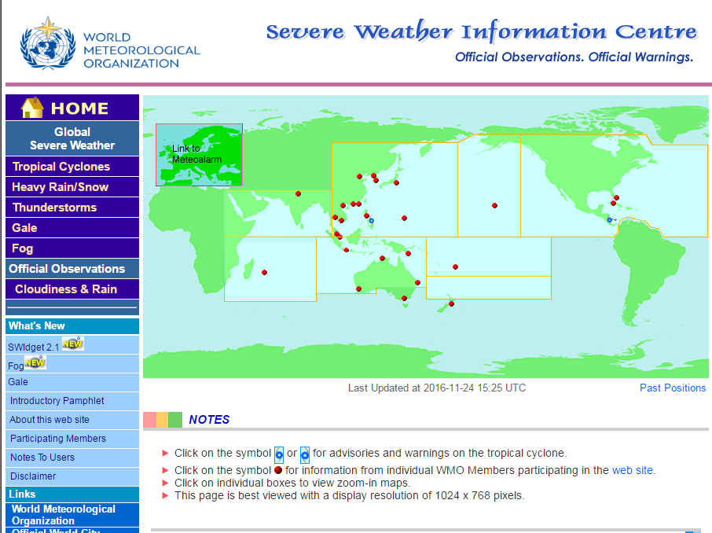
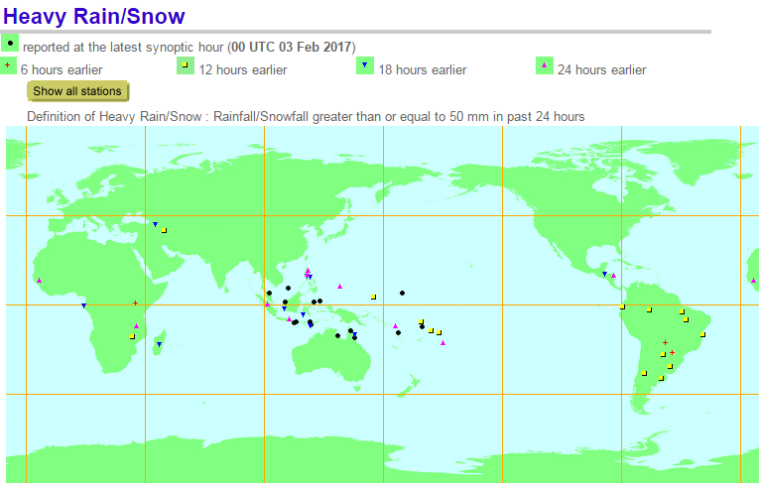
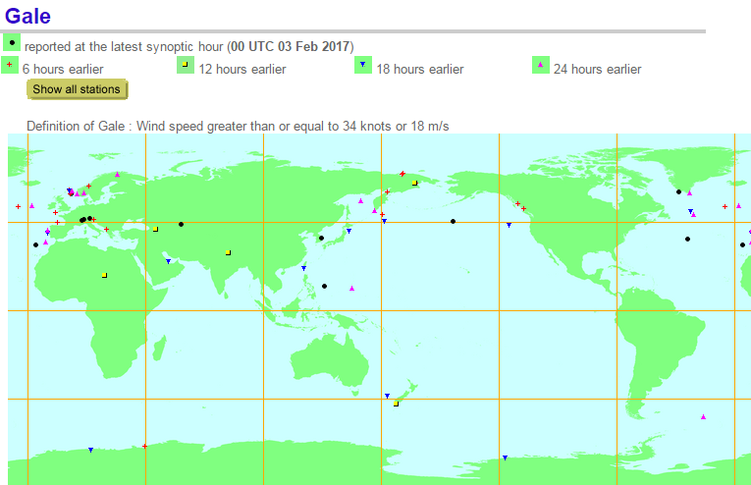
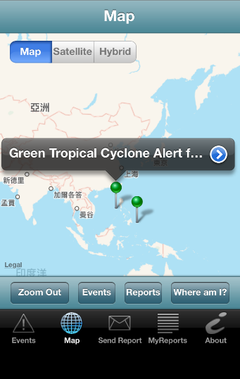
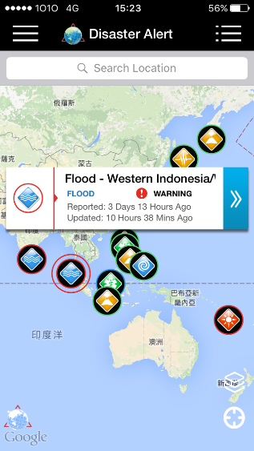
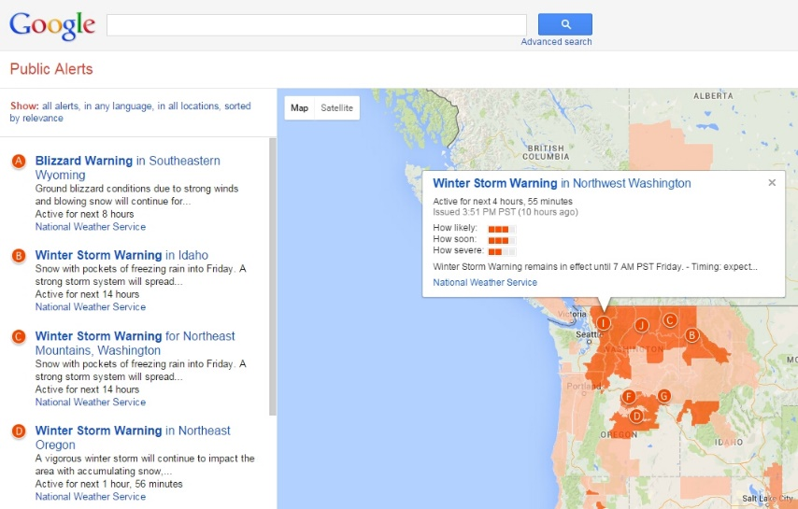
Severe weather information centre (SWIC)
Centralized platform to provide official authoritative warnings and information issued by NMHSs
Contains advisories issued by RSMCs
Features warnings on tropical cyclones and worldwide information on severe weather
Challenges
Not all hazards covered
Inconsistent content/format
Proliferation of warning websites from other sectors

Slide 7
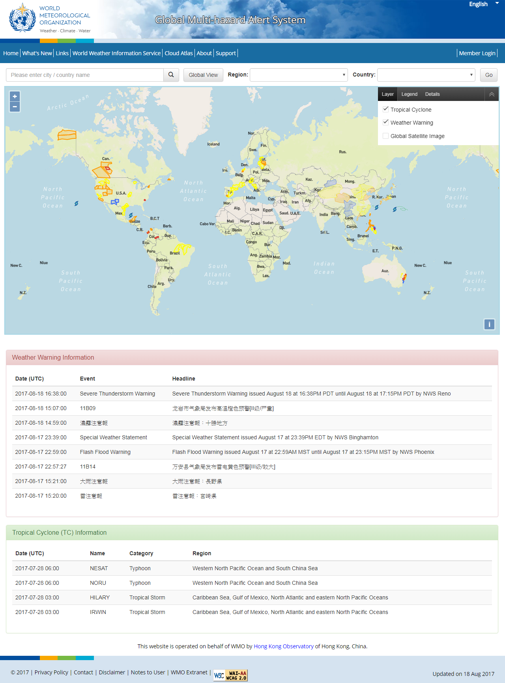
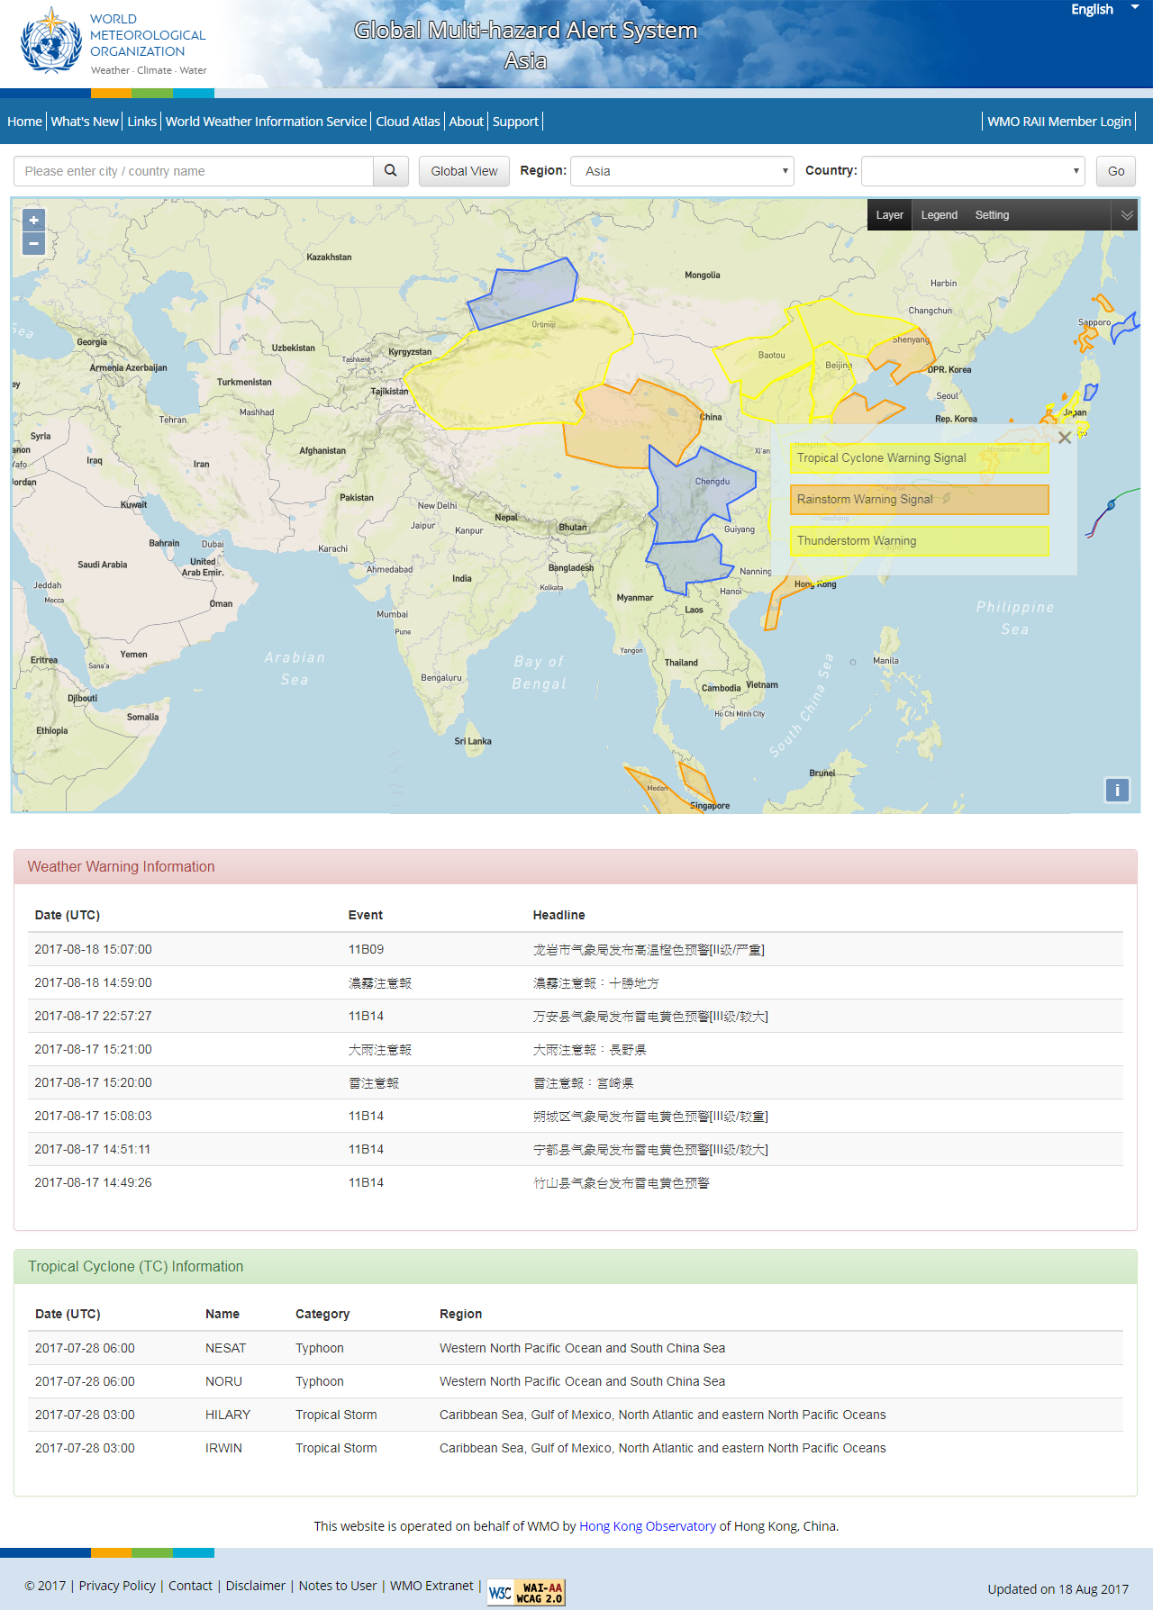
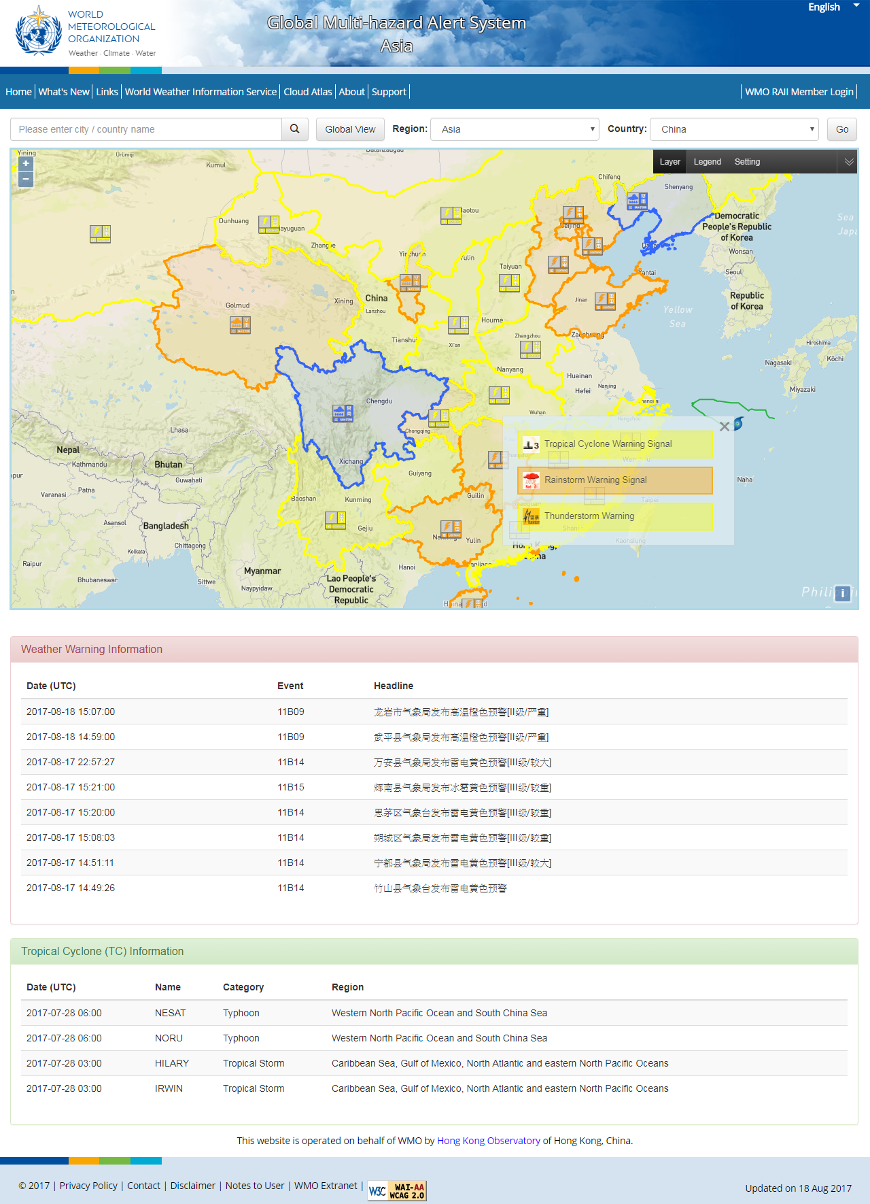
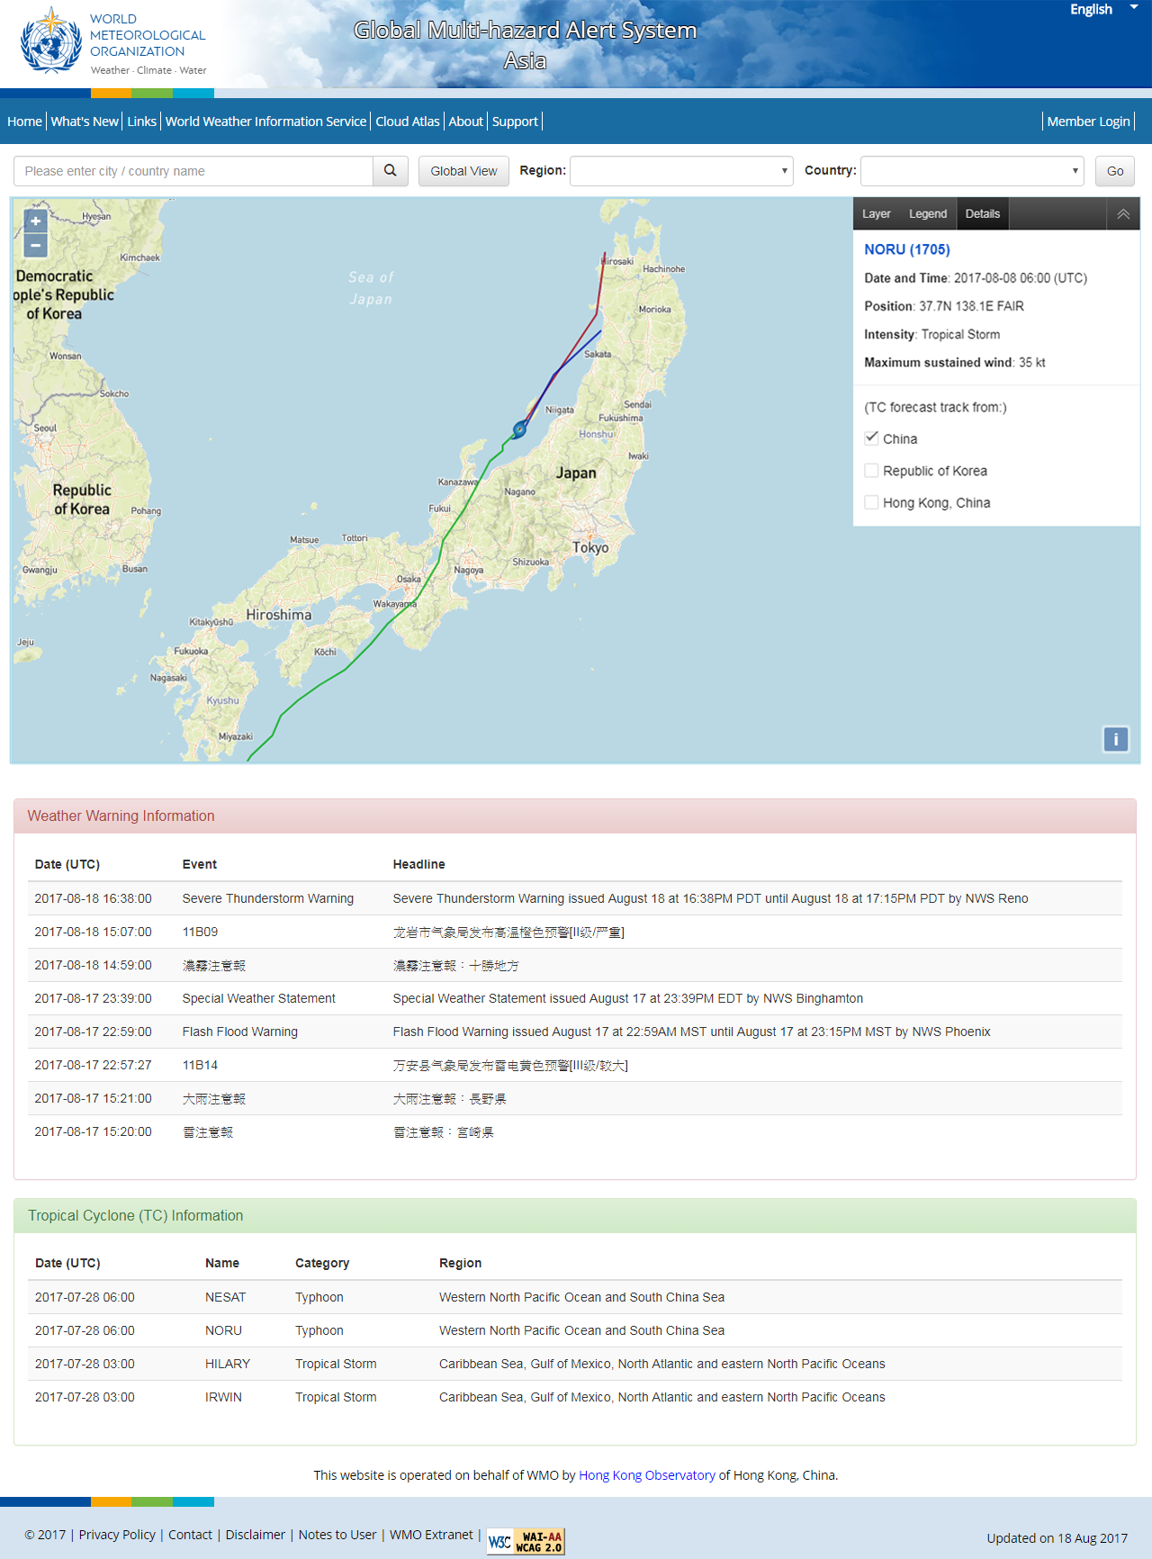
Enabling CAP in SWIC (prototype)
common platform to collate, display & share warnings in CAP format issued by NMHSs
Global View
Regional View
National View
Tropical Cyclone

Slide 8
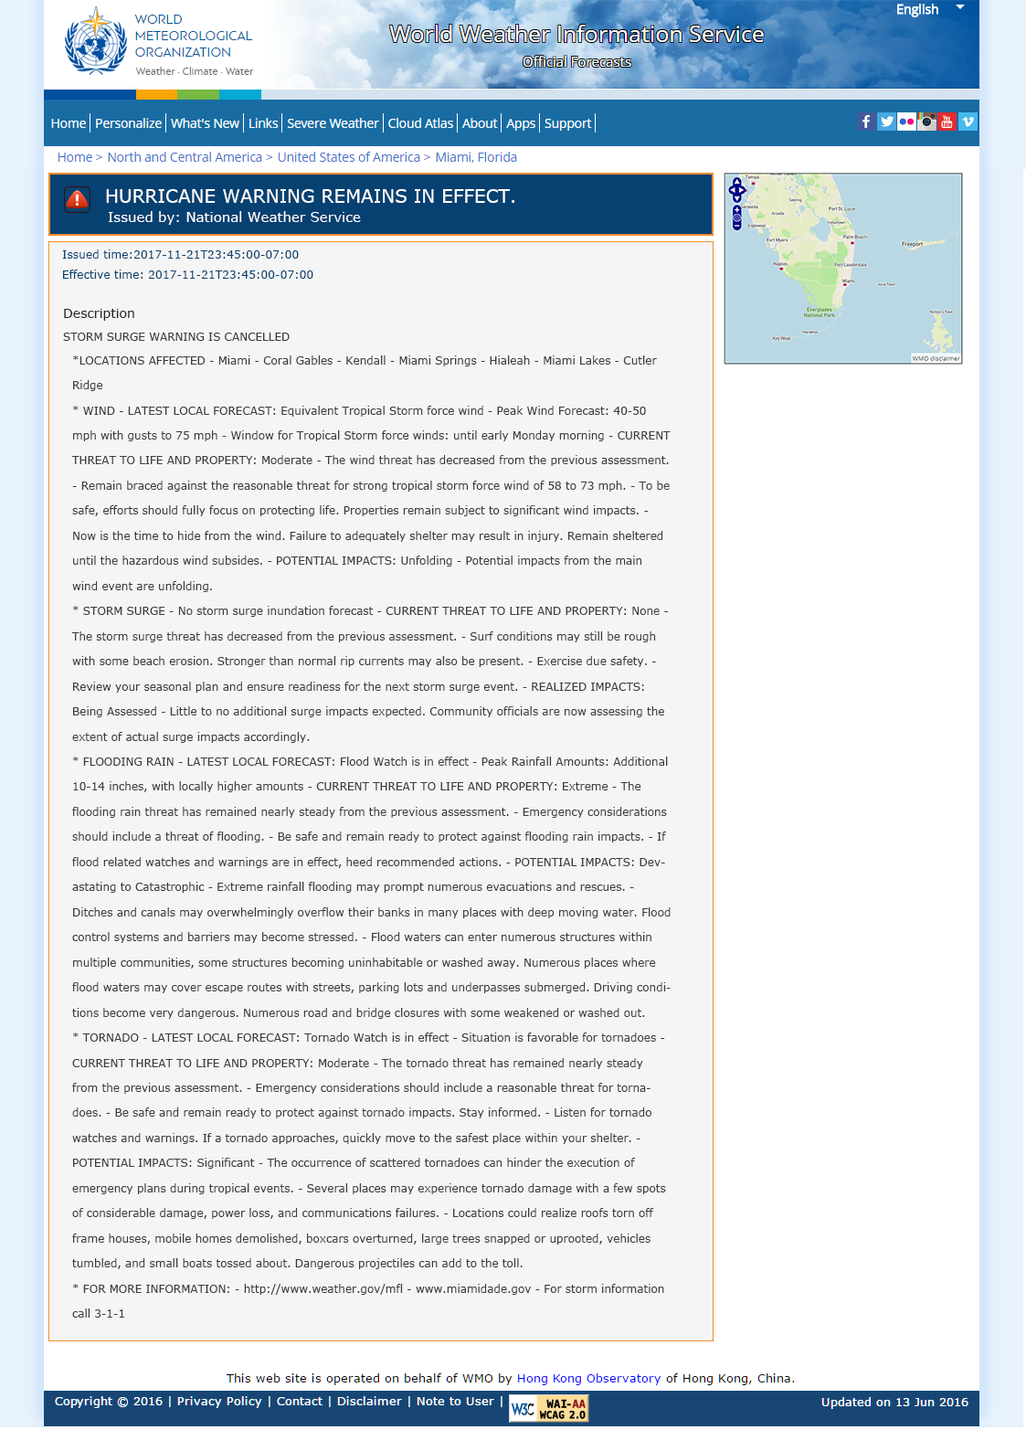
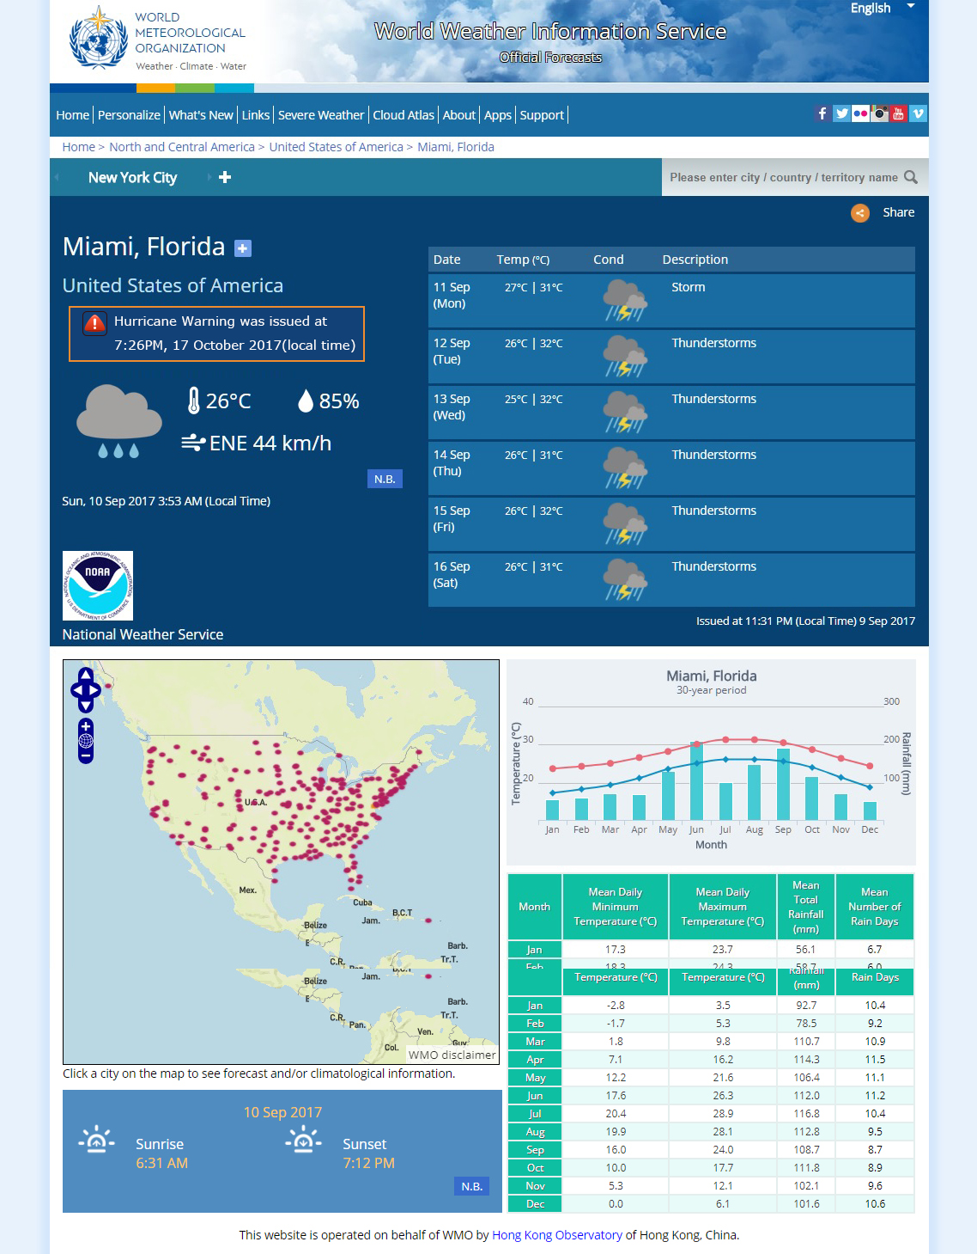
Enabling CAP in other applications
E.g. in WWIS

Slide 9
Plans
Upgrade SWIC to become an online GIS-enable platform to aggregate, display and share authoritative warnings and alerts in CAP format from WMO Alert Hub and other industry standards
A example of display platform for the GMAS
Mature WMO Alert Hub aggregating official alerts and warnings from NMHSs and officially Registered Alerting Authorities (RAAs)
Encourage NMHSs to adopt CAP format for their warnings and disseminate these warnings to WMO Alert Hub and thus SWIC
Enhance WWIS to become a online GIS-enable platform for official weather observations, authoritative forecasts and warnings provided by NMHSs around the world
To implement RA II Pilot Project on Regional GMAS (Resolution 5.2/10 (RA II-16))

Slide 10

Thank you

Slide 11
Regional GMAS in Asia
RAII-16 approved the pilot project to enhance the capability of meteorological disaster risk reduction (Resolution 5.2/10)
To establish a regional system, based on the implementation of CAP and the experience in WMO WWIS and SWIC
To promote experience sharing among NMHSs in RAII in disaster risk reduction
To organize training courses
To provide assistance to relevant RAII members to improve operational capability in meteorological risk reduction
CMA and HKO as co-coordinators

Slide 12
Targets of RAII Pilot Project
To develop a prototype of Alert Hub for aggregating CAP alerts issued by NMHSs and an upgraded SWIC website for displaying the CAP alerts with GIS interface by end of 2017
To develop a prototype website for sharing of advisory products among RAII members by mid-2018.
To develop plans for training and development of advisory products for RAII members in early 2018

